Slide 1
PHY 102 – Atoms to Galaxies
Sections 15/16
Dr. Carl J. Wenning
Syllabus on Physics Department Server
  http://goo.gl/521EWv
Get lab manual at bookstore; labs start during 3rd week
Get clickers and licenses at bookstore
Special needs accommodations

Slide 2
Scientific Epistemology
Dr. Carl J. Wenning
Department of Physics
Illinois State University

Slide 3
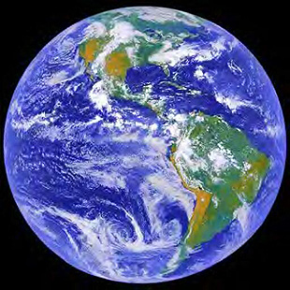
How can we know anything?
We say that Earth is spherical….
We say that Earth orbits the sun annually….
We say that Earth spins daily on its axis….
Do we know, or do we merely have faith?

Slide 4
If the Earth is spinning,…
we should feel the motion,
we should feel the winds,
we should see the oceans cast off,
we should see projectiles left behind,
and yet we don’t.

Slide 5
If we claim to know something,...
we should be able to state the source of that knowledge.
“How do you know?”

Slide 6
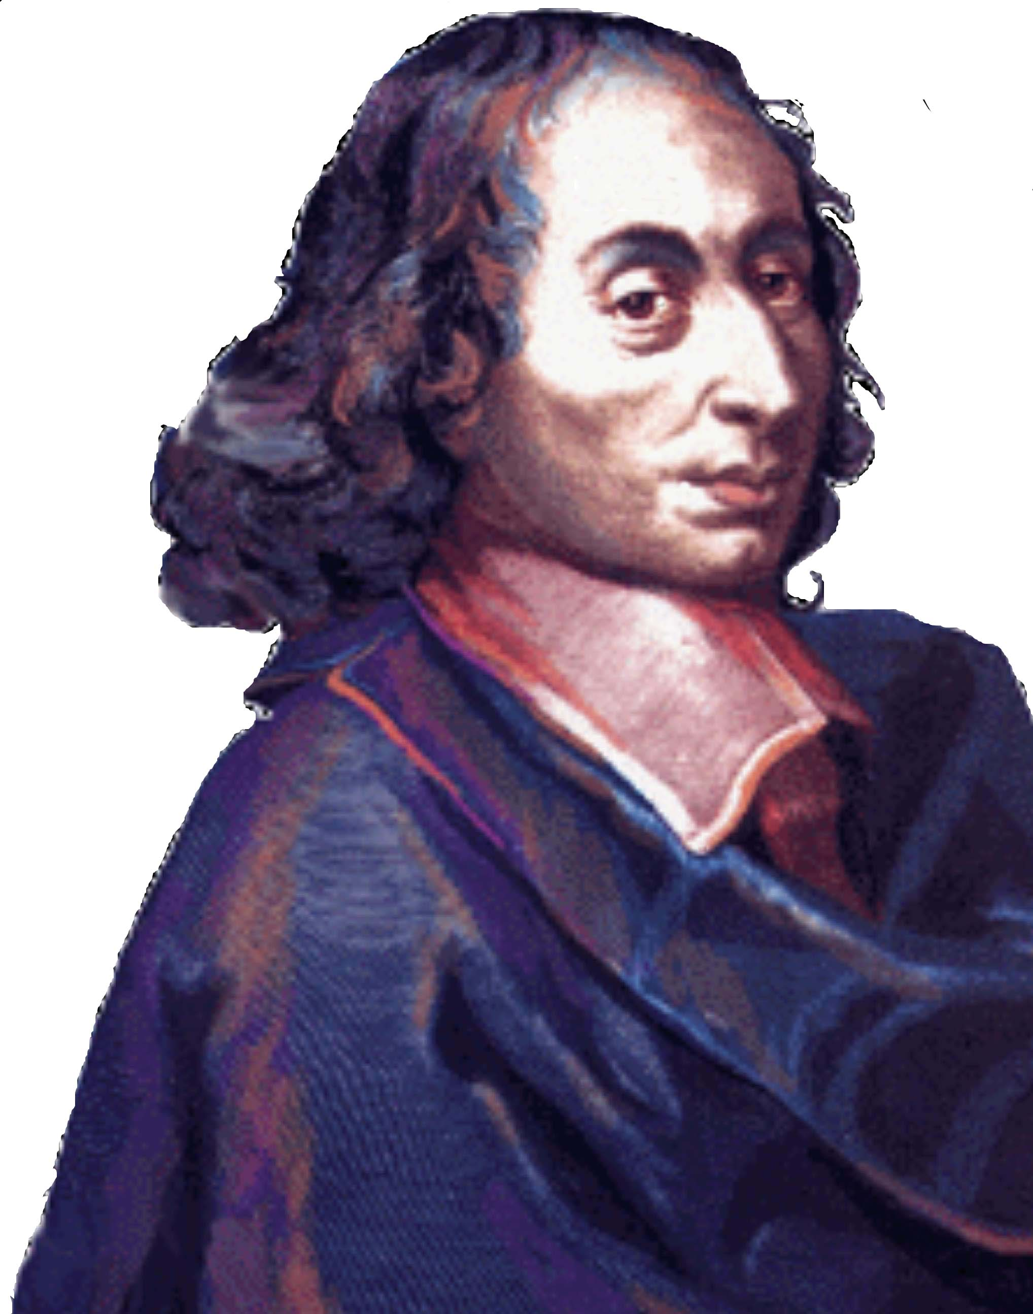
According to Blaise Pascal,
“Opinion is the mistress of error; she cannot make us wise, only content.”
Right reason and empirical evidence together serve as the basis of scientific knowledge.

Slide 7
Human reason is limited
We are weak in our infirmities.
Outlook can sway our reason:
  We believe what we want to believe.
  We take facts as opinions if we don’t agree, and opinions as facts if we do agree.
We can gain false first impressions.
It was once thought that heavier things would fall faster.
If we can’t trust reason alone, then how can we actually know anything?

Slide 8
Personal Experience
When you have burned your hand, you know it.
If you see someone shot, you know it.
Caution: Identical concrete experiences can be interpreted a multitude of ways (e.g., witnesses)

Slide 9
Artificial Inference
Axiomatic proofs of mathematics.
4x + 2 = 6
Therefore, x = 1
Caution: These conclusions can be flawed if one doesn’t know and understand the rules (e.g., 2 = 1).

Slide 10
Natural Inference - Syllogisms
Humans, when cut, bleed.
I am human.
Thus, when cut I’ll bleed.
Caution: The primary and/or secondary premises can be flawed.
  The North Star shows the direction north.
  The brightest star in the sky is the North Star.
  The brightest star in the sky shows north.
Modus ponens

Slide 11

Definition
An author is some one who writes a book.
Therefore, any one who writes a book is an author.
Caution: Definitions do not constitute knowledge per se. You might know the name of something, but nothing about it.

Slide 12
Universal Consent
Indiana is between Ohio and Illinois.
The Eiffel Tower is in Paris, France.
Caution: Just because “everyone” believes something to be so, doesn’t make it so. It was once believed that diseases resulted from humans having displeasured the gods, that the Earth was flat, and that the Earth was at the center of the universe

Slide 13
Perfect Credibility
A boxed animal sounds like a dog, barks like a dog, feels like a dog, licks your fingers like a dog, smells like a dog. Thus, it must be a dog.
Caution: All the evidence at one time pointed to the fact that the Earth stood still, but today scientists claim to know that it both rotates daily on its axis and revolves annually around the Sun.

Slide 14
Credible Authority
What is your name? How do you know?
Christmas is a legal holiday. How do you know?
Caution: Not all authorities are credible. Many leaders preach contradictory beliefs. They can’t all be correct.

Slide 15
Science: Observation
Asking a question about a natural phenomenon
Making observations of the phenomenon
Hypothesizing an explanation for the phenomenon
Predicting a logical consequence of the hypothesis
Testing the hypothesis by an experiment or further observation
Drawing a conclusion or creating a revised hypothesis based on new data

Slide 16
Science: Experimentation
Observational facts & problem identification
Hypothesis generation & prediction
Experimentation:
  Can data disprove a hypothesis?
  Can data support a hypothesis?
  Can data prove a hypothesis?
If data support hypothesis, then prediction… experimentation…prediction…
Theory development (misconception: theories become laws)

Slide 17
Science: Analysis
Derivation of knowledge using logic & empirical evidence.
  Induction – moving from specific cases to general rules
    Principles
    Laws
  Deduction – moving from general rules to specific cases
Proof - evidence or argument establishing or helping to establish the correctness of a statement:
  Earth as a spherical shape
  Earth spins daily on its axis
  Earth orbits the Sun annually

Slide 18
What is truth?
Truth is “what is”. Something that is true is consistent with reality.
Two types of truth:
  Subjective – in relation to the subject (e.g., I think that the painting is beautiful – This truth is in the eye of the beholder)
  Objective – in relation to the object (e.g., The painting is hanging on the wall – This truth is consistent with what is.)
Objective truth is the goal of science, but scientists never claim to possess it. Scientific knowledge is subject to revision in the light of new evidence.

Slide 19
What is Science?
Science is a truth-seeking process
Science is a body of knowledge based on logic and evidence
Caution: Deeper truths exist even when objective truths contradict (relativity).
How does science differ from:
  religion?
  pseudoscience?
Does science represent knowledge or faith?

Slide 20
Knowledge and Faith are Beliefs
Faith is belief based upon certain assumptions or a presumed authority – statements of faith NOT testable.
Knowledge is belief based on empirical evidence and logic – statements of knowledge ARE testable.
  When you say you know a fact, you can cite evidence for that knowledge.
  Knowledge can be subject to error and is, therefore, tentative and subject to change
  Scientific knowledge in particular is durable.

Slide 21
Credibility of Belief Systems
Knowledge, faith, and opinion are ALL subject to error.
Some types of belief systems are more trustworthy than others.
What roles do right reason and empirical evidence play in your belief system?

