Slide 1
Updates
Be certain to read ahead in the Student Laboratory Handbook – graphing articles
Office Moulton 312B
Office Hours: MWF 1:00 – 1:30pm and by appointment
Office phone: 438-3236 (only office hours; don’t leave messages)
Best way to contact me is via email (cjwennin@ilstu.edu)
Get your clickers and site licenses, and register them. We will begin using after Labor Day. I will be using them for 10-point in-class quizzes, extra credit, and understanding checks.

Slide 2
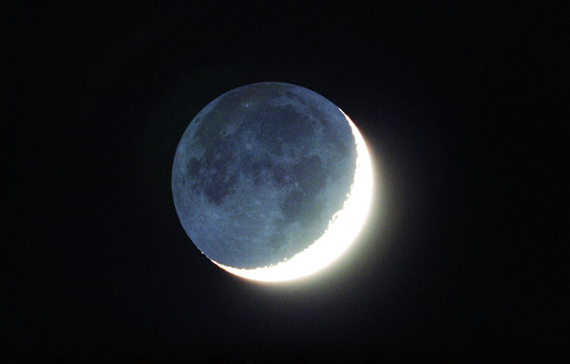
Philolaus’ Cosmology

Slide 3
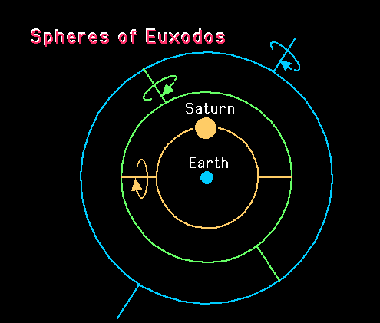
Retrogrades of Superior Planets

Slide 4
Aristarchus & Eratosthenes and Models of the Solar System

Slide 5
Aristarchus & Heliocentrism
Determines relative sizes of Earth and Moon from eclipse shadow. Moon ~1/3 Earth diam.
Determines Earth-Moon distance ~25 Earth diameters.
Uses quarter phases of moon to determine Sun’s distance ~20 times lunar distance.
Concludes Sun 7 times Earth diameter.
Claims that Sun is the focus of motion.

Slide 6
No Evidence to Support Heliocentrism
Aristarchus’ heliocentrism doomed due to a lack of empirical evidence.
Lack of scientific arguments to counter Aristotle’s proofs of a non-moving Earth:
Lack of sensation… • Earth not losing oceans…
Lack of winds… • Projectiles not left behind…
Lack of expected stellar parallax of either form:
If all stars are equidistant, then…
If stars are at varying distances, then…

Slide 7
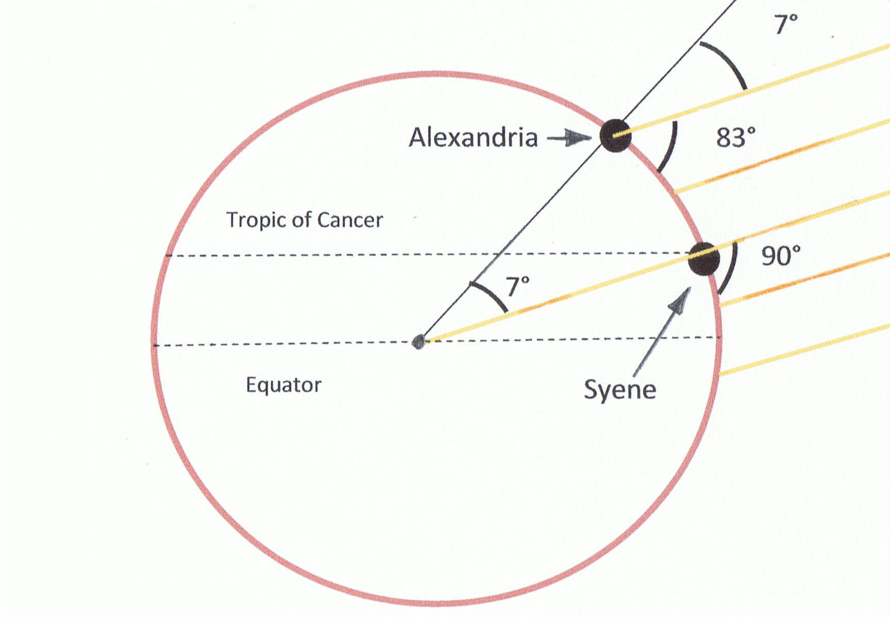
Eratosthenes & the Size of Earth
How could Earth move given its great size?

Slide 8
Geocentrism Revisited
Homocentric spheres of Eudoxus
Apollonius suggests epicycles and deferents:
Homocentric spheres model did not account for planets brightening when opposite the Sun.
Homocentric spheres model did not accurately predict the motions of the planets

Slide 9
The Ptolemaic System
An extension of Apollonius’ deferent (the carrier) and epicycle (the upon-circle)
Ptolemy accepts and utilizes the perfect circular planetary motion of Plato and Aristotle.
Off-sets the Sun’s orbit around Earth to account for the irregular motion of the sun through the constellations and the varying seasonal lengths.
Off-sets the Moon’s orbit around Earth to account for the irregular motions of the Moon.

Slide 10
The models of Eudoxus, Appolonius (Ptolemy), and Copernicus (Kepler)
http://www.youtube.com/watch?v=FnKNQwilPPc

