Slide 1
Copernicus, Brahe, & Kepler
(and a bit about graphs)
Sections 3.1-3.3

Slide 2
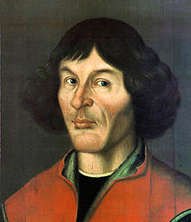
Nicholas Copernicus
19 February 1473 – 24 May 1543
Sees that Ptolemaic system both inaccurate and overly complex.
Proposes a simpler sun-centered system to explain lunar, solar, and planetary motion.
Includes perfect circular motion
Retains tiny epicycles on orbits to explain irregular motions.

Slide 3
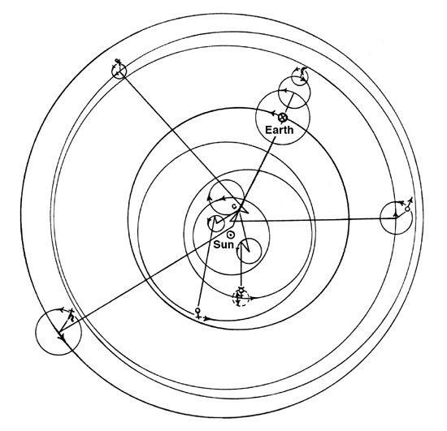
Copernican System

Slide 4
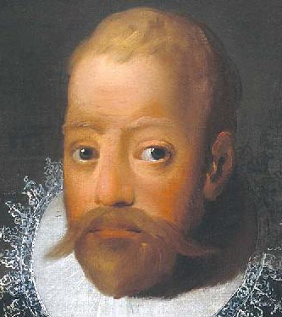
Tycho Brahe
14 December 1546 – 24 October 1601
Appreciates simplicity of Copernican system, but cannot accept Earth motion.
Copernican system seen as too Catholic in the Protestant north of Europe.
Merges systems of Ptolemy and Copernicus:
  Unmoving Earth
  Sun and Moon orbit Earth
  Planets orbit Sun

Slide 5
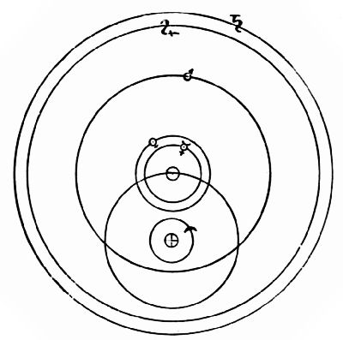
Tychonic System

Slide 6
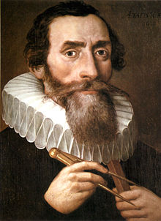
Johannes Kepler
December 27, 1571 – November 15, 1630
Rejects perfect circular motion following study of Mars.
Discovers three laws:
  Elliptical motion
  Equal areas
  period² = distance³
System accepted today.

Slide 7
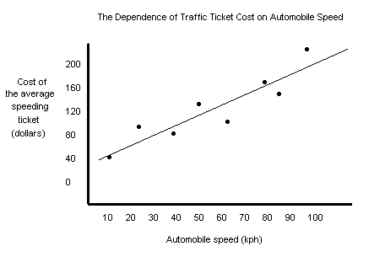
A bit about graphs…
(in preparation for next week’s lab)
Graphs are used to find relationships between variables.
In a linear relationship, y = mx + b
Be certain to pre-read your lab manual before entering lab next week.
Optional: Read SLH – http://www.phy.ilstu.edu/slh/

Slide 8
Weekly Reflection #2
State and explain one convincing scientific proof demonstrating the rotation of Earth.
Restrict your response to 100 words.
Submit to me at cjwennin@ilstu.edu
Due to me no later than Tuesday before class.
I will send detailed email late this evening.
Quiz #1 is next Tuesday.
10 MC questions
As always, a reading quiz is due before next class on Mallard.

