Slide 1
Graphing

Slide 2
Reminders and Updates
The first lab is THIS week and is due by Friday; see syllabus for complete details.
Syllabus has been further updated.

Slide 3
Things you need to know…
Plotting individual points (x, y)
Regression line (best fit line)
Slope, m = Δy/Δx = (y₂-y₁)/(x₂-x₁) (include units)
y-intercept, b (include units)
Algebraic relationship: y = mx + b
Physical relationship: replace y by variable on y-axis and x by variable on x-axis
Relationships – proportional, linear, inverse, etc

Slide 4
Things you must be able to do…
Plot data points on a graph or read coordinates of a plotted point.
Determine and interpret the slope of a straight-line graph, including units.
Determine the y-intercept, including units.
Find a physical relationship using y=mx+b
Determine the value of a dependent variable given the value of an independent variable as well as appropriate constants.

Slide 5
Introduction to Graphical Analysis
Using either Vernier’s Graphical Analysis or Vernier’s Logger Pro
A demonstration…

Slide 6
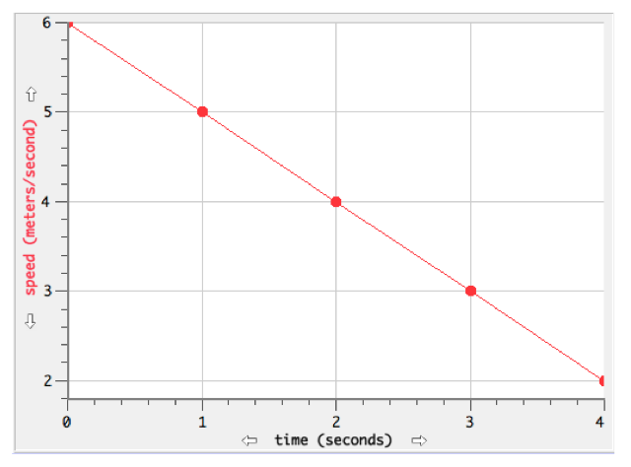
Example #1

Slide 7
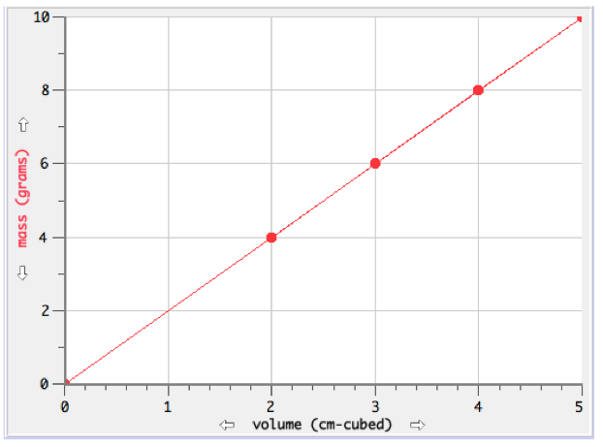
Example #2

Slide 8
Readings
Be certain to read and complete “Graphing Exercises” hyperlinked to course syllabus for today.
Remember that readings about “Graphing” in Student Lab Handbook are required.

