Slide 1
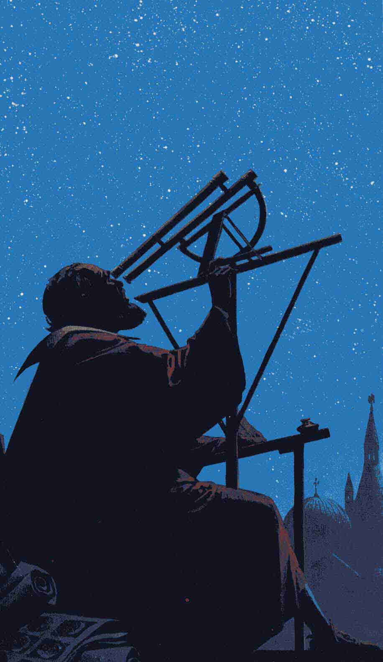
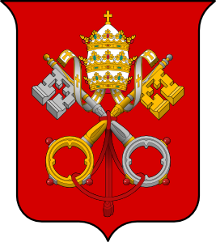
Galileo & the Church
Dr. Carl J. Wenning
ISU Physics Department

Slide 2
Who was Galileo?
Hero or villain?
Saint or sinner?
Martyr or victim?
A common man who, with his telescope and methodology, did many extraordinary things for science between 1609 and 1642.

Slide 3
Galileo’s importance
Galileo was an Italian physicist, astronomer, mathematician, and philosopher who played a major role in the Scientific Revolution.
Perhaps more than any other person, Galileo was responsible for the birth of modern science.
15 February 1564 – 8 January 1642

Slide 4
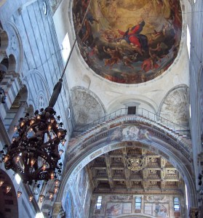
What role does observation play in solving the mysteries of nature?

Slide 5
What role does experimentation play in solving the mysteries of nature?

Slide 6
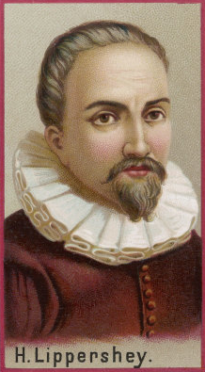
Invention of the telescope
Galileo did not invent the telescope, but he was first to turn it productively to the sky.
Telescope was invented in the workshop of Hans Lippershey of Holland probably in 1608.
Galileo, a lens maker, immediately grasped the concept and made his own.

Slide 7
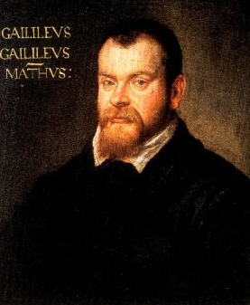
Galileo’s telescopes: 9x, 20x

Slide 8
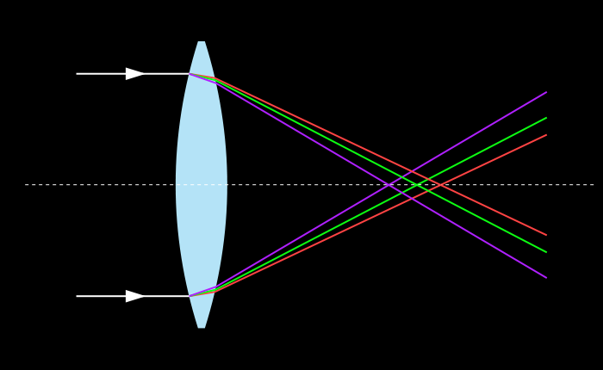
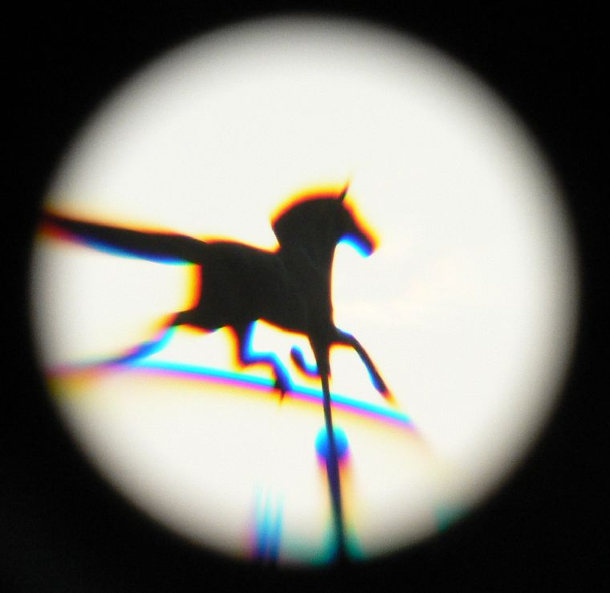
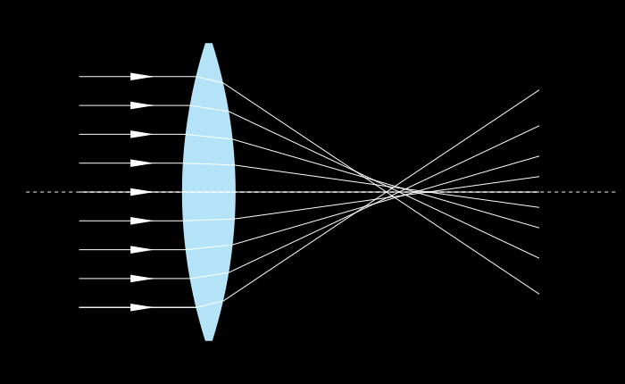
Optical Aberrations

Slide 9
Other telescope problems
Telescope powers:
Magnifying
Light Gathering
Resolving
Limitations:
Small field of view
Lack of a suitable mount

Slide 10
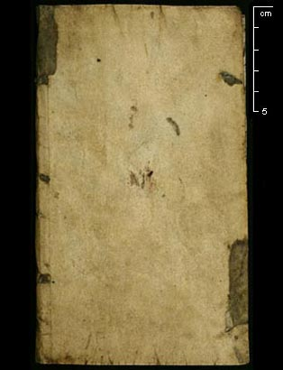
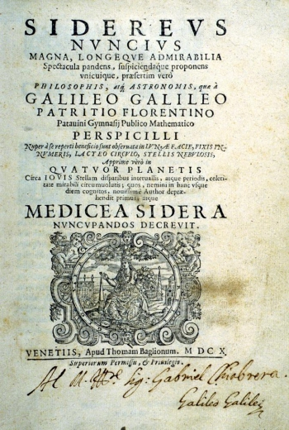
Sidereus Nuncius…1610

Slide 11
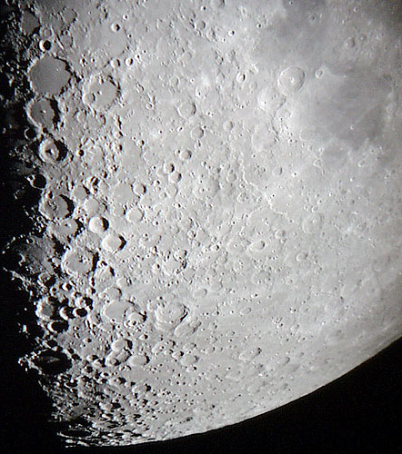
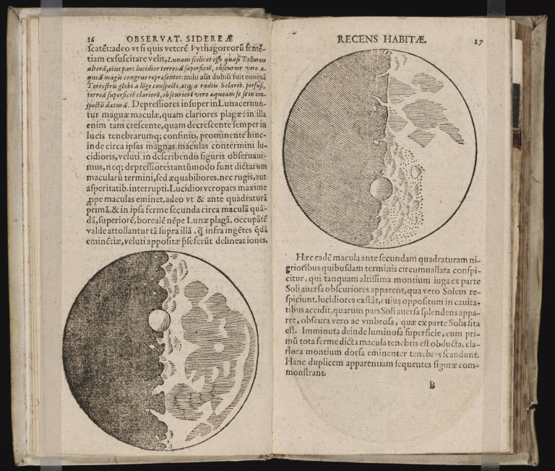
Craters of the moon

Slide 12
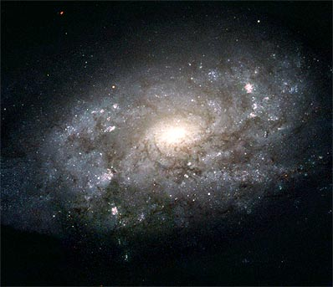
Nebulous regions

Slide 13
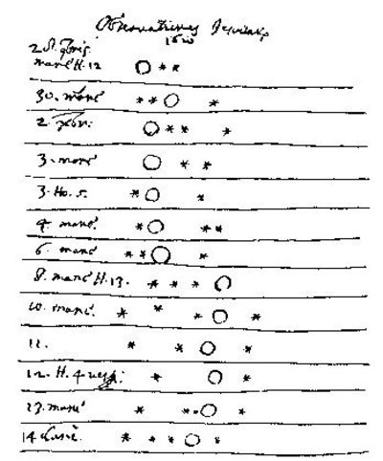
Moons of Jupiter

Slide 14
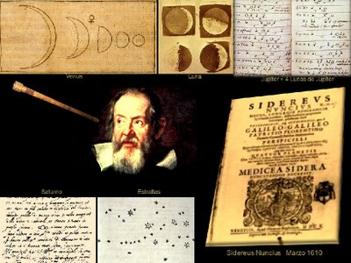
Subsequent observations

Slide 15
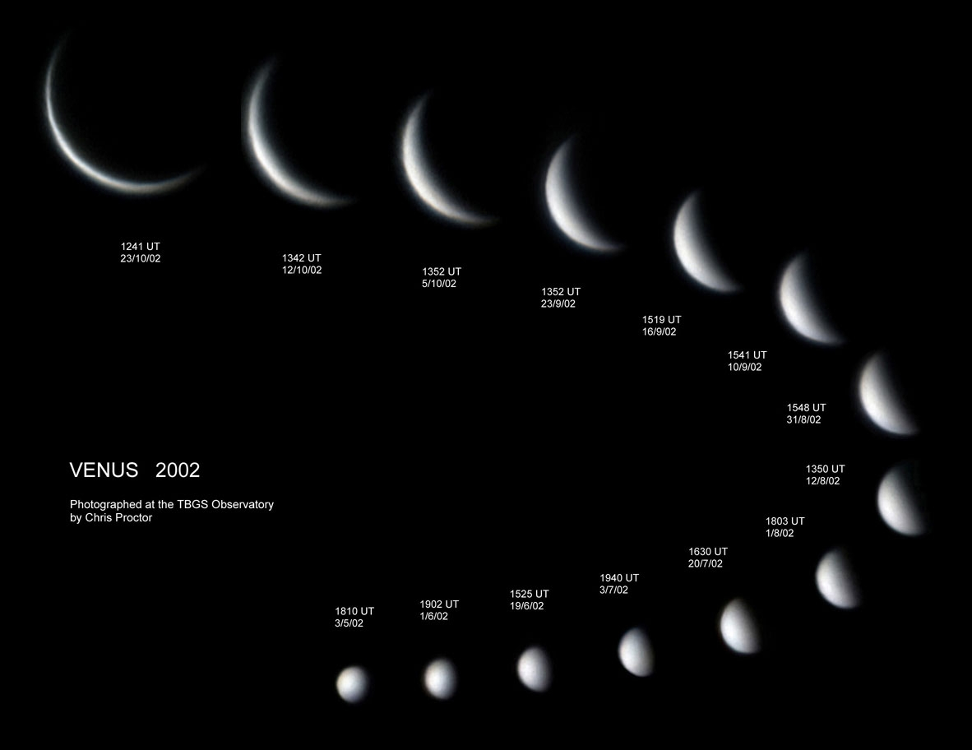
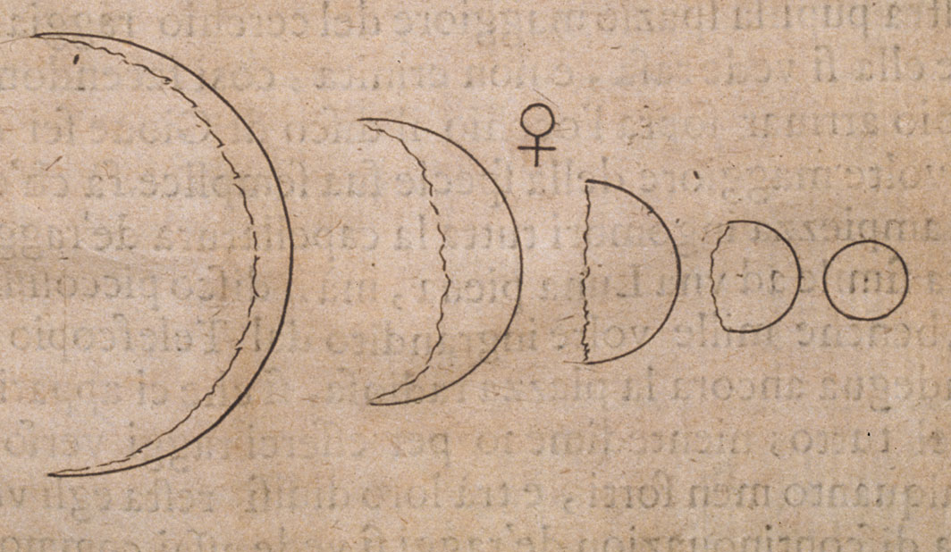
Phases of Venus

Slide 16
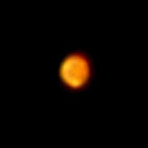
Changing size of Mars

Slide 17
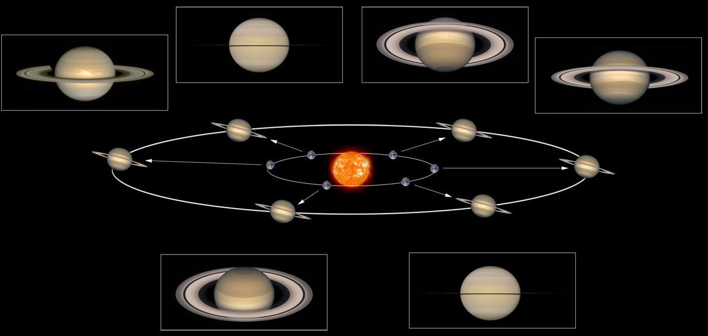
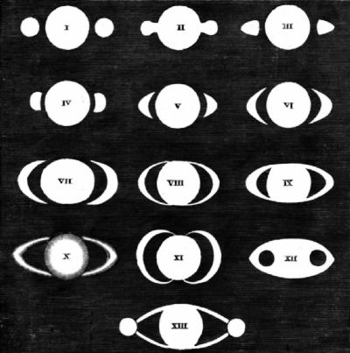
Triple-Starred Saturn

Slide 18
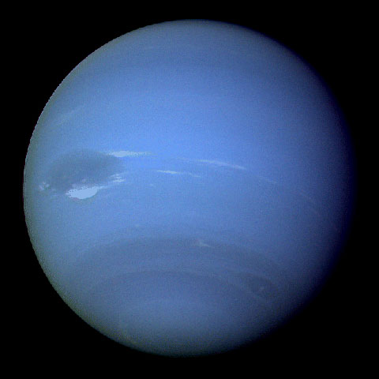
Neptune

Slide 19
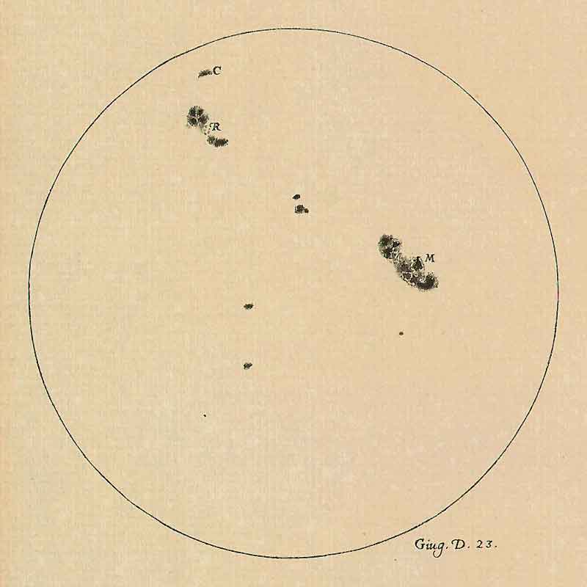
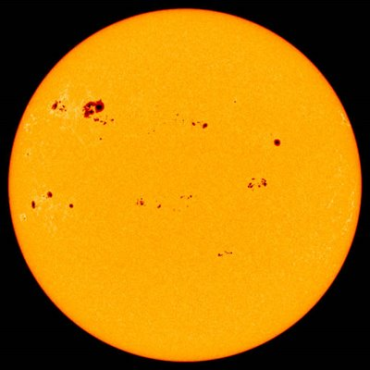
Sunspots

Slide 20
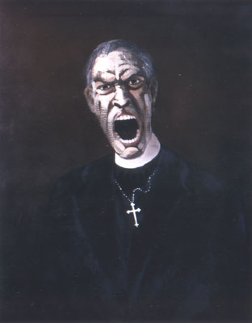
The early antagonists
The “Pigeon league” and Rev. Tommaso Caccini, “Ye Galileans, why stand ye there looking up into the heavens?” (cf Acts 1:11)
German observer Rev. Christoph Scheiner argues with Galileo about primacy of discovering sunspots.

Slide 21
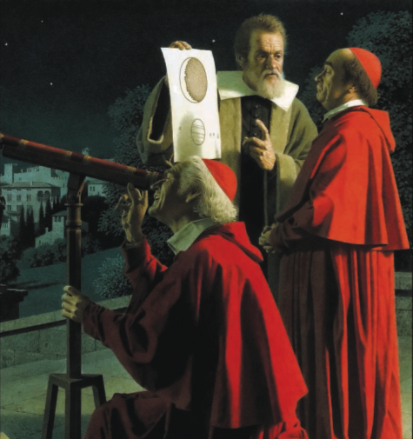
Galileo makes his case in Rome

Slide 22
Skepticism!
How can a telescope show what the eye does not reveal?

Slide 23
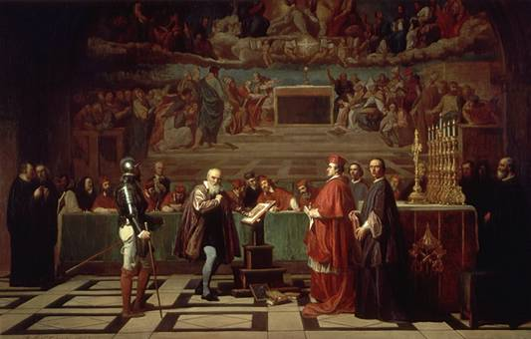
Galileo and the Church
Sidereus Nuncius was not the main source of Galileo’s problems with the Church.

Slide 24
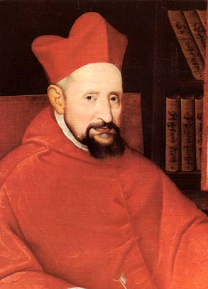
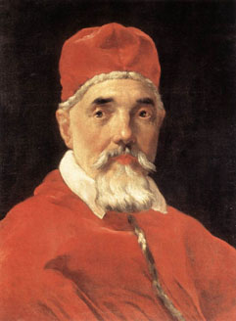
Origins of controversy
Galileo denounced to Inquisition in 1614
Galileo meets with Robert Cardinal Bellarmine in 1616
Maffeo Cardinal Barberini becomes Urban VIII in 1623
Galileo begins his magnum opus…

Slide 25
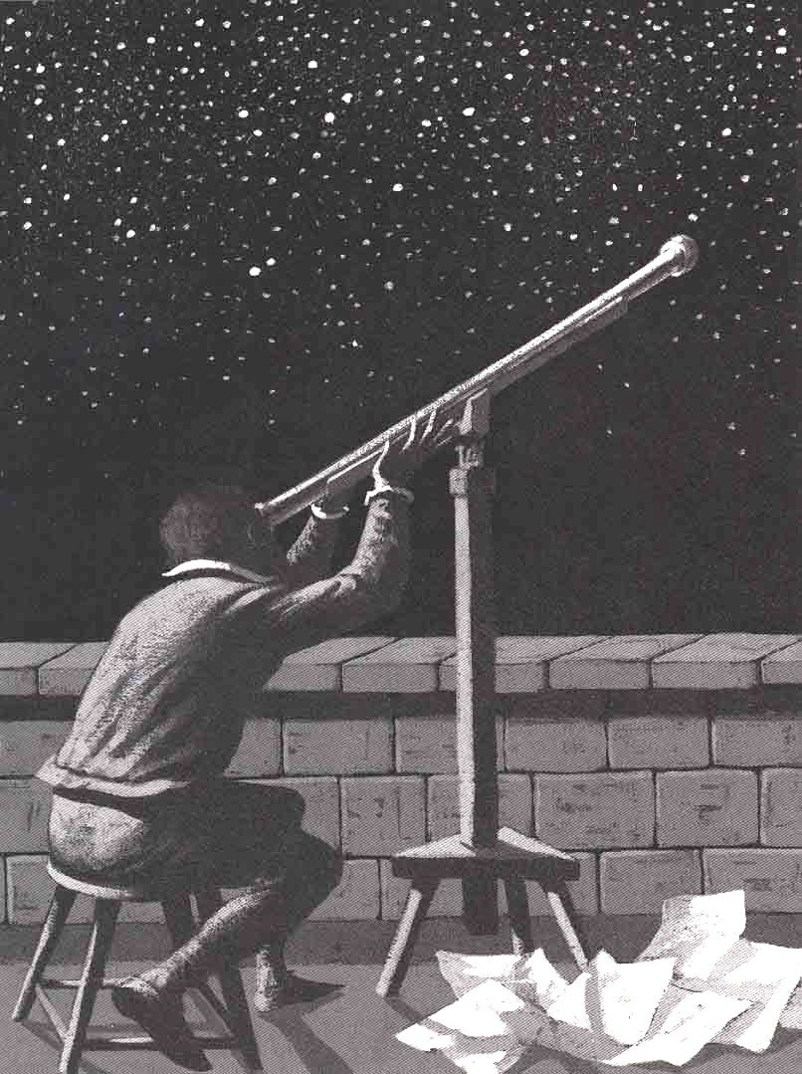
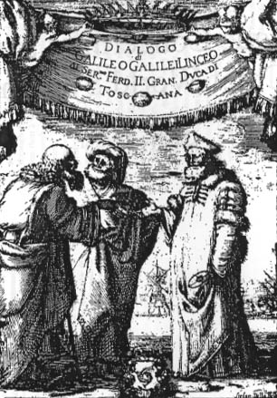
Dialogues Concerning the Two Chief World Systems
1632

Slide 26
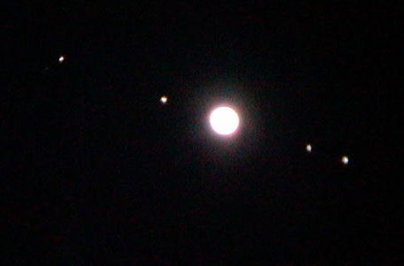
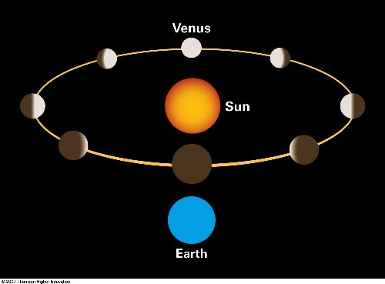
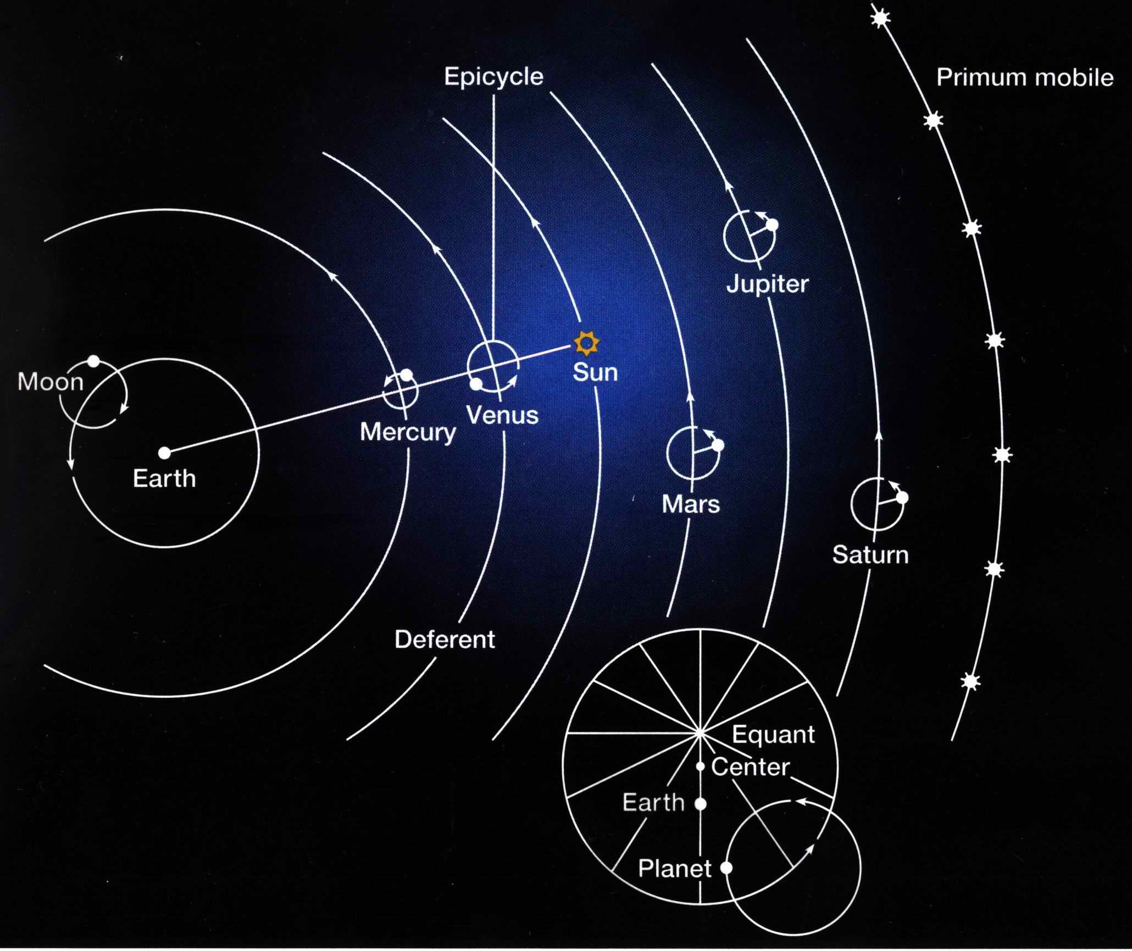
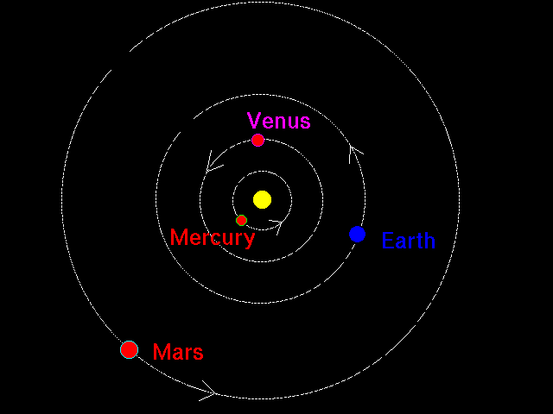
Implications of observations

Slide 27
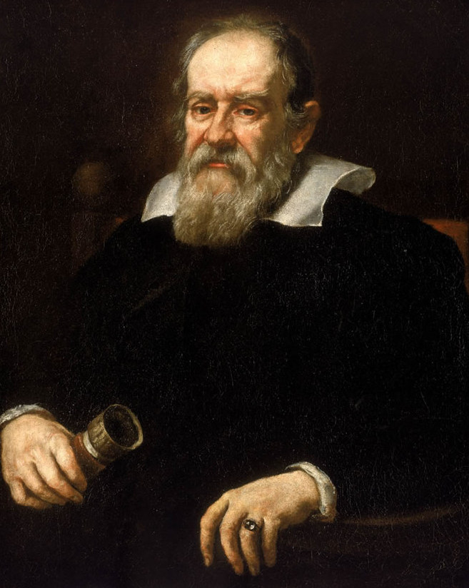
In Dialogues Galileo…
predicated the movement of Earth, placing the Sun at the center of the known universe - Copernicanism
contradicted established religious and scientific opinions of his day
made incontrovertible arguments based on empirical evidence

Slide 28
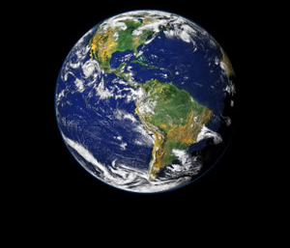
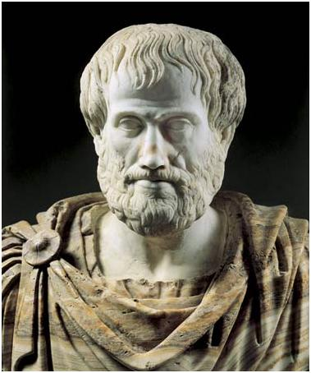
But does Earth move?
Today commonly held as true, but is it?
Aristotle argued convincingly against it:
constant motion is not natural
any motion should be felt
projectiles should be left behind
prevailing winds should blow from the east
things should be flung off at the spinning Earth’s equator
stellar parallax should be visible

Slide 29
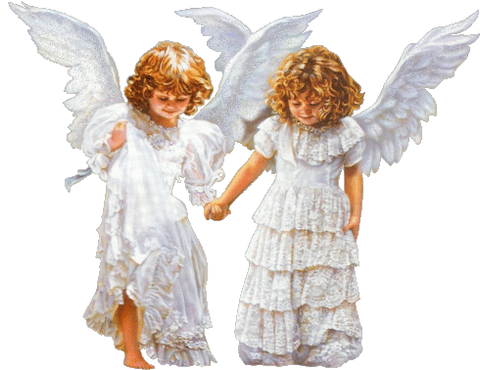
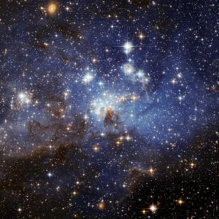
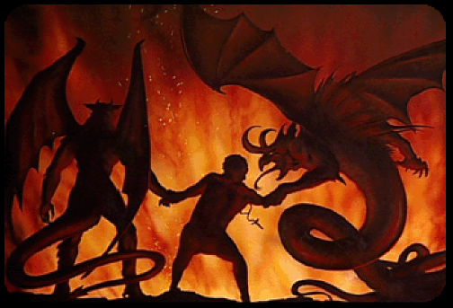
Shouldn’t Earth be at the center?

Slide 30
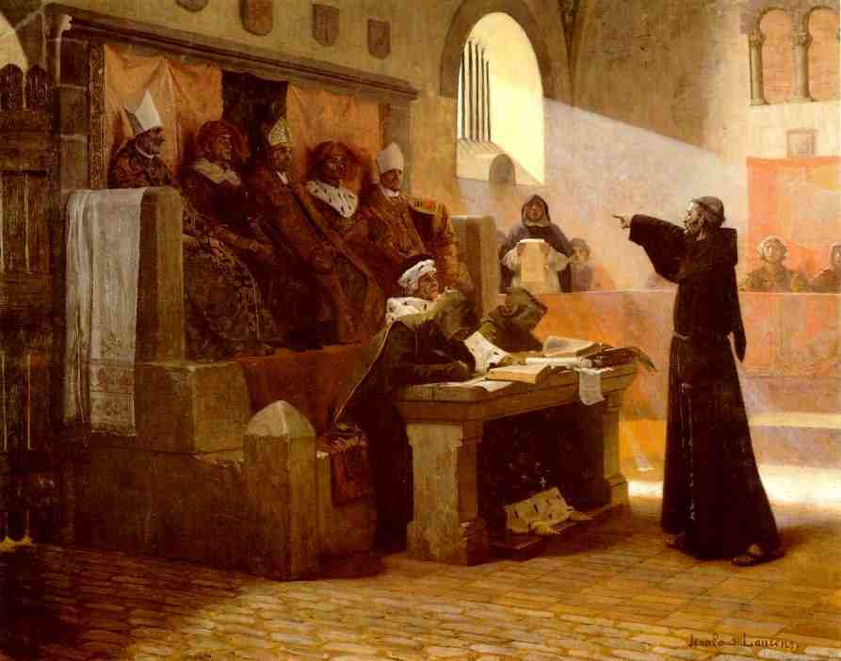
The 1632 accusation

Slide 31
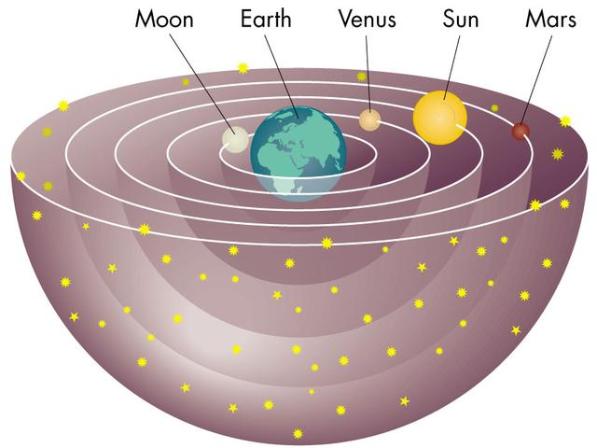
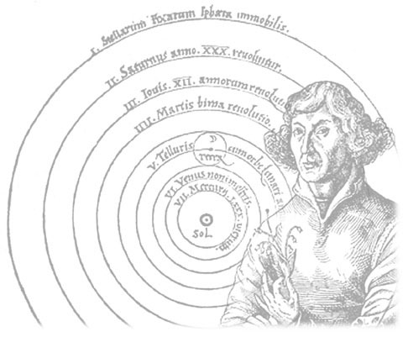
Suspicion of heresy!
Holding and promoting the pernicious doctrine that the sun is the center of the world, and that the Earth moves and is not the center of the world

Slide 32
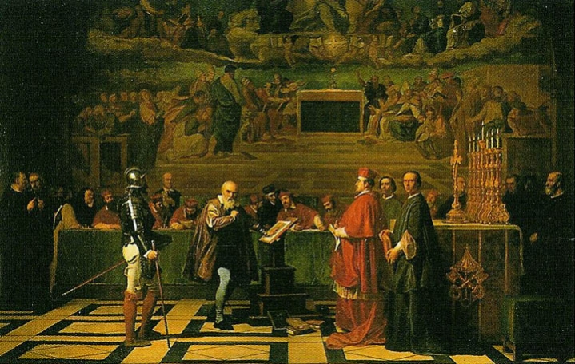
Galileo’s trial
Hinged on a literal interpretation of Biblical texts* (“Sun, stand thou still upon Gibeon; and thou, Moon, over the valley of Ajalon.” Joshua 10:12, KJV)
Condemnation based on faulty records of 1616 meeting with Robert Cardinal Bellarmine made by the Holy Office
Also based on “secret prohibition” of 1623 arising from visit with Pope Urban VIII
* 1 Chronicles 16:30; Psalms 93;1; 96;10; and 104:5

Slide 33
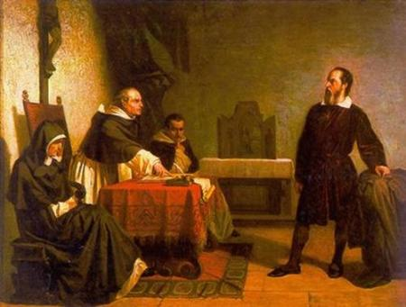
Galileo’s defense
Ecclesiastical approbation for publication of Dialogues Concerning Two Chief World Systems
“The intention of the Holy Spirit is to teach how to go to heaven, not how go the heavens.” Cardinal Piccolomini
A 1616 letter from Robert Cardinal Bellarmine
Supposedly incontrovertible evidence was not admissible in the trial:
telescopic observations of Venus, Mars, and Jupiter
1604 nova and explanation of the Earth’s tides
evidence showing Aristotle was wrong about motion

Slide 34
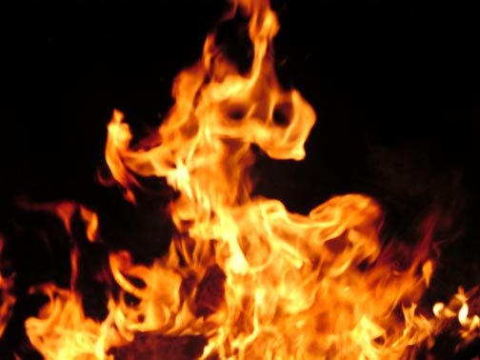
The majority opinion
Our final sentence: We pronounce, judge, and declare, that you, the said Galileo . . . have rendered yourself vehemently suspected by this Holy Office of heresy, that is, of having believed and held the doctrine (which is false and contrary to the Holy and Divine Scriptures) that the sun is the center of the world, and that it does not move from east to west, and that the earth does move, and is not the center of the world; also, that an opinion can be held and supported as…

Slide 35
…probable, after it has been declared and finally decreed contrary to Holy Scripture, and, consequently, that you have incurred all the censures and penalties enjoined and promulgated in the sacred canons and other general and particular constituents against delinquents of this description. From which it is Our pleasure that you be absolved, provided that with a sincere heart and unfeigned faith, in Our presence, you abjure, curse, and detest the said error and heresies, and every other error and heresy contrary to the Catholic and Apostolic Church of Rome.

Slide 36
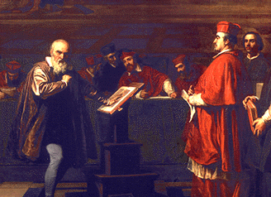
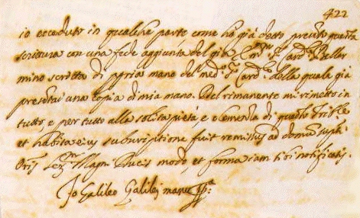
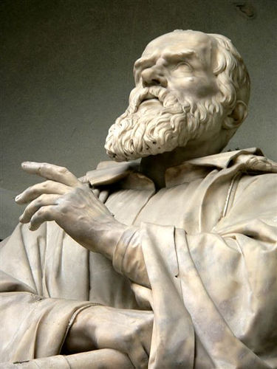
Galileo recants under threat
Pope Urban VIII does not sign the condemnation of Galileo

Slide 37
The sentence
Recite the seven penitential psalms once/week for 3 yrs
Formal prison of Holy Office (changed to house arrest for the remainder of his life)
Dialogues put on Index of Forbidden Books
Wide publication of his recantation

Slide 38
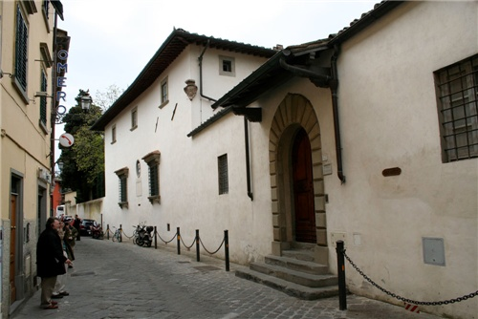
What Galileo did not do…
He did not “set Earth in motion around the Sun”
He did not forsake the Church
He did not lose all support of churchmen, friends, colleagues
Archbishop Piccolomini
Suor Maria Celeste
John Milton (Paradise Lost)
Marin Mersenne (Dutch publisher of Two New Sciences in 1638)

Slide 39
John Paul II and Galileo
In 1984 retracted the Inquisition’s most unfortunate condemnation
In 1992 vindicated Galileo
In 2000 issued a formal apology

Slide 40
At fault for his trial…
Church’s reaction to Reformation
Aristotlean scientists of the time (e.g. Magini, chair of astronomy)
The “Pigeon league” and Rev. Tommaso Caccini’s preaching
The grievances of co-claimant German Jesuit Reverend Christoph Scheiner
Pope Urban VIII (Muffeo Barberini) who listened to Galileo’s Jesuit antagonists
Unfortunate circumstances surrounding Galileo’s 1616 and 1623 discussions.

Slide 41
Galileo also at fault
Galileo’s brash personality
Use of the vernacular Italian in his scholarly writings rather than Latin
Did more than teach heliocentric world view as a hypothesis

Slide 42
Church not always antagonistic
Thomas Aquinas warned against the dangers of unqualified literal interpretation of the Bible
Copernicus re-suggests heliocentrism (1543)
Pius XII issues Humani Generis (1950)
John Paul II saw the possibility of “a fruitful harmony between science and faith, between church and the world” (1994)

Slide 43
Lessons learned…
Religion and science are fundamentally different ways of knowing
Empirical evidence is the final arbiter in science
Scientific findings are tentative but resilient
There will be no contradiction between faith and science if both are properly understood
Scientists need not be atheists
Church supports science

