Slide 1
Kinematics: Describing Motion

Slide 2
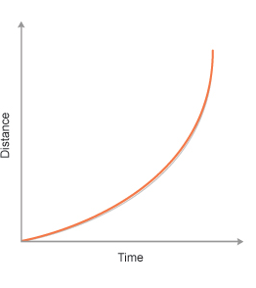
Uniformly Accelerated Motion
Interpreting graphs
Equations:
  v_{inst} = v_{o} + at
  x = x_{o} + v_{o}t + ½ at²
  v_{inst}² – v_{o}² = 2aΔx
Vectors
Sign conventions
Sample problem…

Slide 3
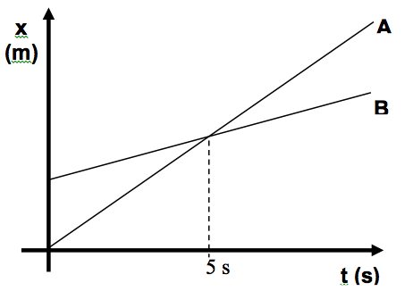
Graph Review 1
Which of the following statements most accurately describes the motion of bicycle A during the first 5 seconds?
a. Bicycle A is constantly at rest.
b. Bicycle A is moving with a constant speed
c. Bicycle A is traveling up hill
d. Bicycle A is moving in a direction opposite that of bicycle B

Slide 4
Graph Review 2
Which of the following statements most accurately describes the motion of bicycle B in comparison to bicycle A at t=5s?
a. Bicycle B is going faster than bicycle A.
b. Bicycle A is passing bicycle B.
c. Bicycle B is speeding up.
d. Bicycle B is moving in a direction opposite that of bicycle A.

Slide 5
Graph Review 3
In a position-time graph (position in cm on the y-axis and time in s on the x-axis) of a constant-motion toy car the y-intercept is -3.
What is/are the unit(s) on the -3?
a. cm
b. cm/s
c. cm/s²
d. s

Slide 6
Graph Review 4
In a position-time graph (position in cm on the y-axis and time in s on the x-axis) of a constant-motion toy car the y-intercept is -3.
What is the physical interpretation of -3 along with its units?
a. the car’s position at t=3s
b. the car’s position at t=0s
c. the car’s position 3s before the clock starts
d. none of these

Slide 7
Equations of Motion
Constant Motion (a = 0)
Uniformly Accelerated Motion
d = d_{o} + v_{ave}t
v_{inst} = v_{o} + at
d = d_{o} + v_{o}t + (½)at²
v_{inst}² – v_{o}² = 2a(d-d_{o})
General steps for solving simple kinematic (motion) problems:
Determine type of motion – constant or uniformly accelerated motion.
Identify that for which you are looking.
Identify the information you have.
Find an appropriate relationship between all the variables in problem.
Solve the relationship for the unknown variable.
Insert quantities (including units) and solve (including units).
Check to see if your solution seems reasonable.

Slide 8
Graphs of Motion
Constant Motion
Uniformly Accelerated Motion
P-T graphs
  Linear
  Slope = velocity
  Area under line meaningless
V-T graphs
  Horizontal lines
  Slope = acceleration
  Slope = 0
  Area under line = displacement
  Do not give position
P-T graphs
  Curved
  Tangent to curve = velocity
  Area under curve meaningless
V-T graphs
  Non-horizontal lines
  Slope = acceleration
  Slope does not equal 0
  Area under the line = displacement
  Do not give position

Slide 9
Equation Review 1
A rock at rest is dropped from a bridge and falls 11.2m before reaching the water. The magnitude of the acceleration due to gravity is 9.81m/s².
How long does it take the rock to reach the water below? Ignore the presence of wind resistance.
a. 1.14s
b. 1.51s
c. 2.28s
d. none of these

Slide 10
Equation Review 2
How fast is the rock in the last question going when it hits the water?
a. 11.2m/s
b. 14.8m/s
c. 22.4m/s
d. none of these answers

Slide 11
Position, Distance, Displacement
Position – magnitude and direction (vector) from some arbitrary location.
Distance
  A scalar quantity
  Measured along path traveled
Displacement – measures change in position.
  A vector quantity
  The straight-line distance between where one starts motion and where one ends motion.

Slide 12
Velocity and Speed
Speed = |velocity|
Instantaneous velocity versus average velocity
Tangents to curved P-T graphs are instantaneous velocity.
v_{inst}= v_{o} + at
v_{ave} = (change in displacement)/(time)

Slide 13
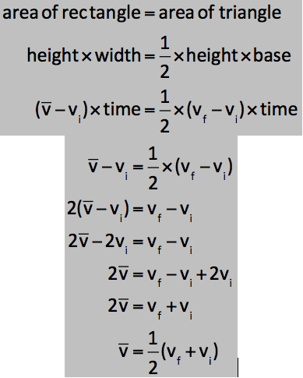
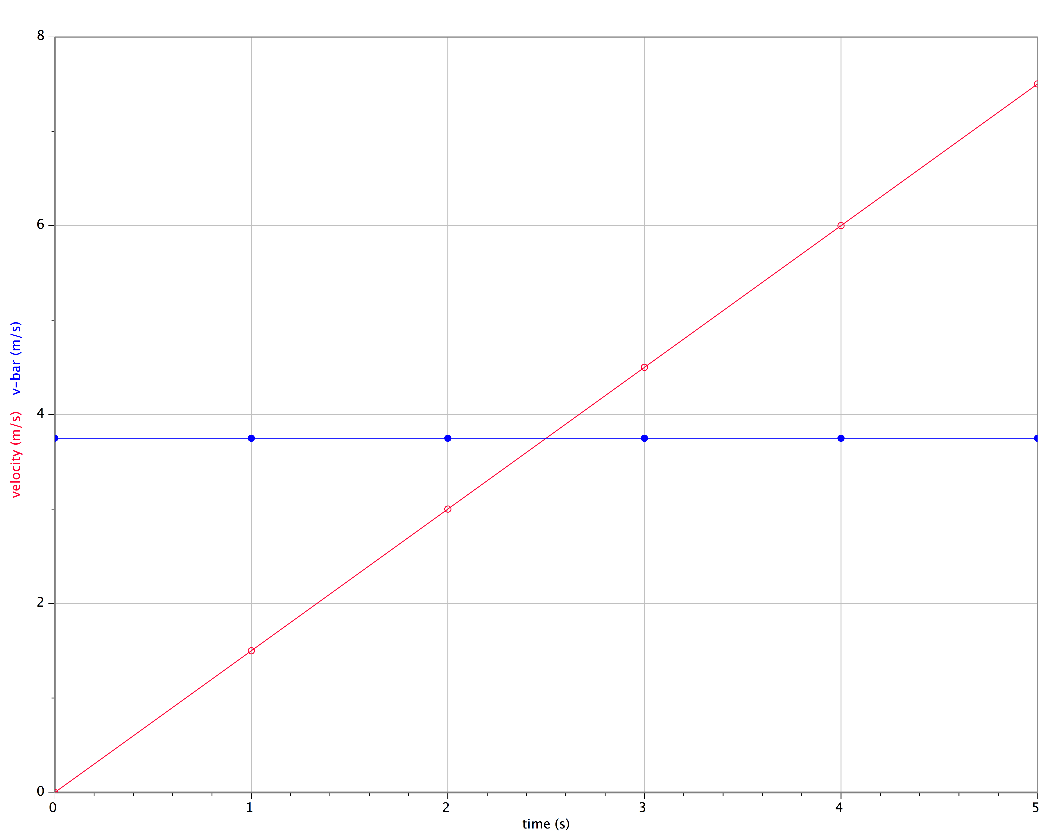
Relationship between v_{ave} and v_{inst}

