Slide 1
Kinematics: Describing Motion

Slide 2
Average Velocity
v_{ave} = Δx/Δt
Caution, averaging rates is always “dangerous” because they are time-based.
Bicycle up and down hill…
Airplane flies triangular circuit.

Slide 3
Uniformly Accelerated Motion
Acceleration is the rate of change of velocity.
a = Δv/Δt = (v₂ – v₁)/(t₂ – t₁)
Acceleration is a vector quantity that can be positive, negative, or zero.
AVOID the use of the vernacular term “deceleration.” It has no legitimate use in physics and can be grossly misleading.

Slide 4
+ and – Acceleration for + Velocity
If an object has a positive velocity and a positive acceleration, it will go faster in the positive direction.
If an object has a positive velocity and a negative acceleration, it will go slower in the positive direction and might even come to a stop and reverse direction.

Slide 5
+ and – Acceleration for – Velocity
If an object has a negative velocity and a positive acceleration, it will go slower in the negative direction and might even come to a stop and reverse direction.
If an object has a negative velocity and a negative acceleration, it will go faster in the negative direction.

Slide 6
Force and Acceleration
Think about the last two slides this way…
The direction of the acceleration is the same as the direction of an applied force.
  What happens when an object is moving to the right and a force is applied to the left?
  What happens when an object is moving to the left and a force is applied to the left?
  What happens when an object is moving to the right and a force is applied to the right?
  What happens when an object is moving to the left and a force is applied to the right?

Slide 7
Acceleration Due to Gravity
The picket fence demonstration...
  P-T graph
  V-T graph
  Acceleration taken from slope of V-T graph

Slide 8
Problems Based on 4 Equations
v_{ave} = dx/Δt (see sample problem 1)
    d = d_{o} + v_{ave}t
a = Δv/Δt (sample problems 2a + 2b)
    v = v_{o} + at
d = d_{o} +v_{o}t + ½at² (see sample problem 3)
v² – v_{o}² = 2a(d-d_{o}) (see sample problem 4)

Slide 9
Sample Problem 1
A vehicle travels 65 meters in 28 seconds. What is the vehicle’s speed?

Slide 10
Sample Problem 2a
A vehicle accelerates from rest to 22m/s in 4 seconds. What is the vehicle’s acceleration?

Slide 11
Sample Problem 2b
A vehicle starting at -5m/s (going to the left) undergoes an acceleration of +1m/s² for 10s. What is the vehicle’s velocity at t = 10s? Describe the motion at t = 10s.

Slide 12
Sample Problem 3
A stone is released from rest from a bridge. The stone falls for 1.2 seconds before hitting the water below. How far does the stone fall?

Slide 13
Sample Problem 4
An airplane lands on a runway going 30m/s. If it slows to a stop with a constant acceleration after going a distance of 900m, then what is the acceleration of the airplane?

Slide 14
Cautionary Notes
Be certain you know your vectors and scalars and how they relate.
  Speed, for instance, is the magnitude of velocity.
      A speed of 3m/s left is greater than 2m/s right
  Distance, for instance, is the length of the path taken; displacement is the straight-line distance from starting point to ending point.
Even an object at rest can have an acceleration, or else it can’t start moving (i.e., object at rest or ball at top of flight path).

Slide 15
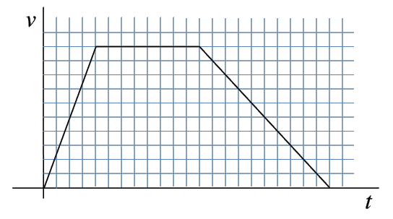
Test Your Graphing Knowledge (3pt EC)
Graph in 3 parts, 1,2,3.
Find displacement, velocity, and acceleration for each of the three segments.
You will need to use equations sometime.
1) v = 2.5m/s² * t
2) v = 10m/s
3) v = 22m/s – (1m/s²)*t

