Slide 1
Gravitation

Slide 2
Newton’s Apple
Perhaps in contemplating the fall of an apple, Newton realized that its acceleration was a_{Earth} = -9.81 m/s² (in modern metric terms).
He knew that the moon’s acceleration toward Earth was

Slide 3
Working…
Earth acts as though all its matter is concentrated in a point at its center.

Slide 4
Working…

Slide 5
Newton Finds Kepler’s Third Law
P² = r³ (P in years; r in astronomical units)
P² = kr³ (arbitrary units)
Newton derives this relationship

Slide 6
Gravitational Field Strength
W = mg
g = gravitational field strength in units of N/kg
g = -9.81N/kg
When simplified,
Hence, g = -9.81m/s²
Gravitational field strength has the units of acceleration and is directed downward.

Slide 7
Warning!
Do not confuse g with G.
g = -9.81N/kg = -9.81m/s²
G = 6.67x10⁻¹¹Nm²/kg²
W = mg = -GMm/r²
g = -GM/r² = -(6.67x10⁻¹¹Nm²/kg²)* (5.97x10²⁴kg)/(6,371,000m)² = -9.81m/s²

Slide 8
Gravitational PE on Universal Scale
PE = mgh = -GMm/r
At cosmic distances,
E_{total} = KE + PE (where PE = 0 at ∞)
E_{total} = ½mv² – GMm/r

Slide 9
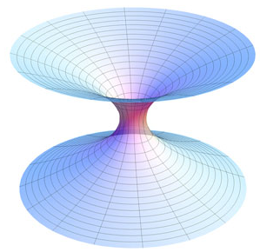
Black Holes
Recall, E_{total} = KE + PE = ½mv² – GMm/r
If E_{total} = 0, then v_{escape} = √(2GM/r)
If E_{total} > 0, then v > v_{escape}
If E_{total} < 0, then v < v_{escape}
In a black hole, M is “normal” but r can be vanishingly small. Hence, when something gets close enough to a black hole it can not escape – even light!

Slide 10
Extra Credit Problems
Three optional extra credit problems follow. You should search your notes, PowerPoints, the Internet, or other resources to find values.
Each problem is worth 1/3 point.
Problems must show all work, beginning with mathematical equations.
This optional assignment is due in hard copy at the start of class on Wednesday.
Clearly label each problem with its number and be certain to place a box around each answer.

Slide 11
Problems #1 and #2
#1 Show that the local value of “g” (the gravitational field strength) on the surface of the moon is approximately 1/6 that on the surface of Earth. Note that g_{Earth} = -9.81N/kg
#2 How much gravitational force exists between two 1kg lead spheres whose centers are 1m apart from one another?

Slide 12
Problem #3
#3 Show mathematically that the acceleration due to gravity in a 300km high orbit is 91.2% that on the surface of Earth. Assume a radius of 6,371km for Earth.

