Slide 1
Waves

Slide 2
Waves: Key Concepts
Simple Harmonic Oscillator
Terms: frequency (f), period (T), wavelength (λ), amplitude (A); note f = 1/T
Wave forms:
Longitudinal
Transverse
Polarization
d = vt implies v = λf

Slide 3
Simple Harmonic Oscillation
Simple Harmonic Oscillator (SHO) is anything repetitive movement with a restoring force proportional to displacement.
Example 1 – spring, F = -kx where F is the force supplied by a spring. (Force on a spring is kx.)
Example 2 – pendulum (at small angles)
tanθ = F/mg therefore F = mgθ (small angle approximation – angles less than 20 degrees)

Slide 4
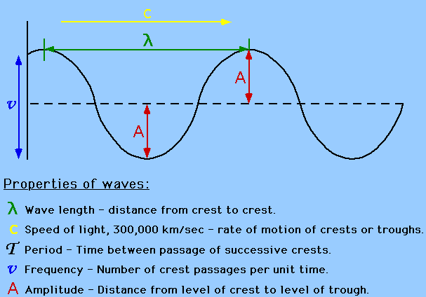
Waveform Terms

Slide 5
Wave Forms
Wave forms:
Longitudinal (compressional motion)
Transverse (side-to-side motion)
Examples:
A water wave is a transverse wave.
Sound is a compressional wave.

Slide 6
Relationships
f = 1/T
Energy propagated by a wave is proportional to A²
d = vt implies… λ = vT; v = λ/T; v = λf
Light propagates at a constant (for all viewers) large but finite speed known as c (such as in Einstein’s famous equation E = mc²)
c = 186,282 miles/second
c = 299,792,458m/s or about 3x10⁸m/s

Slide 7
Example Problems
The frequency of alternating current (for example, 120 VAC) is 60 Hz in the USA. What is its period?
A microwave oven has a frequency of 2,450 MHz. What is its wavelength?
A radio station here in town broadcasts at 92.5 MHz. If its wavelength is 3.24m, what is the speed of its waves?

Slide 8
E. C. Homework Problems (1/3 pt ea) (Due by clicker first thing Wednesday)
The period of oscillation of a pendulum is 2.7 seconds. What is its frequency?
What is the approximate frequency of a 656.3nm wavelength of light? (Note that 1 nanometer = 1.0 x 10⁻⁹ meters, and recall that c = 3x10⁸m/s)
How fast is a wave moving if f = 0.3Hz and λ = 2.3m?

Slide 9
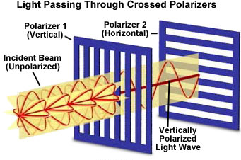
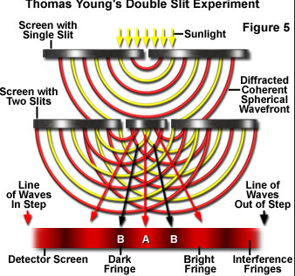
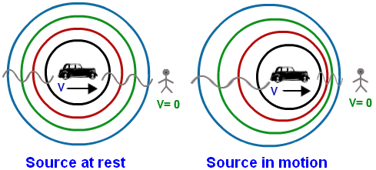
Other Properties of Waves
Polarization
Diffraction
Interference
Doppler effect

Slide 10
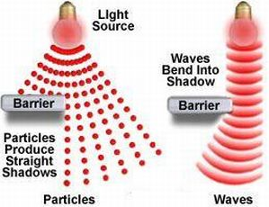
Light
Light acts like both a particle and a wave depending on scale:
Large scale: particle like property: Light travels in a straight line (distinct shadows)
Small scale: Wave like property: Light exhibits diffraction (single slit demo) and interference (double slit demo)

