Slide 1
General Theory of Relativity

Slide 2
‘Boundaries” in Physics
Today we start to cross a second threshold between three types of physics (common to all sciences):
Observational
Experimental
Theoretical
Each of the above relies upon the others, and none stands entirely on its own.

Slide 3
Albert Einstein
Albert Einstein (3/14/79 - 4/18/55, b. in Ulm, Germany) developed special (1905) and general (1916) theories of relativity.
The most influential physicist of the 20th century – if not all time .
Revolutionized physics yet a third time (after Newton and Maxwell)

Slide 4
Einstein
Best known for E=mc²
1905 Annus Mirabilis:
Brownian motion
Special relativity
Photoelectric effect
His 1905 paper “On the Electrodynamics of Moving Bodies” was the birth and source of Special relativity.
In this article he noted that Newtonian mechanics could not be reconciled with Maxwell’s work.
Received the 1921 Nobel Prize in Physics for the photoelectric effect.
Established the basis for quantum mechanics.

Slide 5
Einstein
He realized after creating Special Relativity that the principle of equivalence could also be extended to gravitational fields.
He published his General Theory of Relativity in 1916.

Slide 6
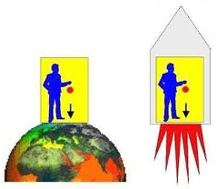
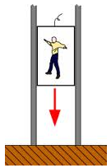
Equivalence Principle 1
Based on the question, “What happens if a reference frame accelerates?”
Weightlessness depends on the frame of reference such as with a falling elevator or a spaceship in orbit around Earth.
Artificial “gravity” occurs in a rocket or spinning spacecraft because of Newton’s first law of motion.
This artificial “gravity” cause by acceleration cannot be distinguished from gravity caused by the presence of matter.

Slide 7
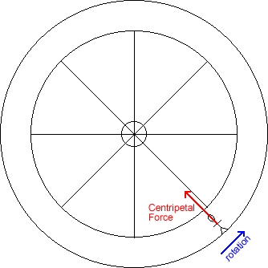
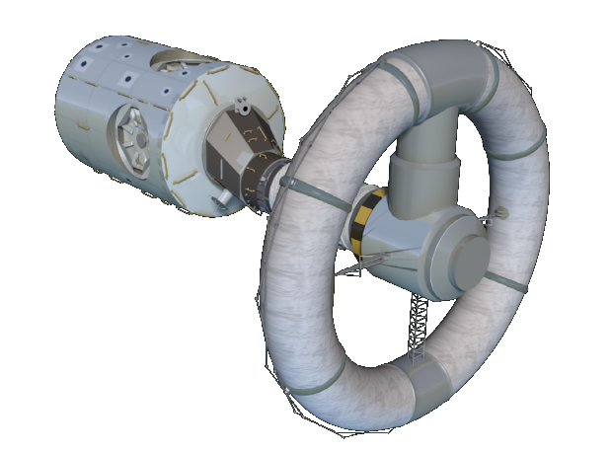
Equivalence Principle 2
Inertial frames of reference are those in which Newton’s laws of motion apply.
All small freely falling reference frames are inertial (Newton’s 1st law holds – no fictitious forces).
A small, uniformly accelerated reference frame is indistinguishable from a reference frame in which there exists a gravitational field.
To create an (artificial) gravitational acceleration (or force) in a given direction in a reference frame, accelerate the frame in the opposite direction.

Slide 8
Consequences of Equivalence Principle
Prediction: Deflection of Light’s Path
An apple thrown or light beam shot across the short axis of accelerating rocket is deflected.
Prediction: Gravitational Doppler Shift
When moving against a gravitational field, light loses energy (E = hc/λ) while speed remains constant.
Prediction: Gravitational Time Dilation
Note that λ/T = c. (Recall that λf=c and f=1/T). If λ increases, then T increases. Gravity slows clocks.

Slide 9
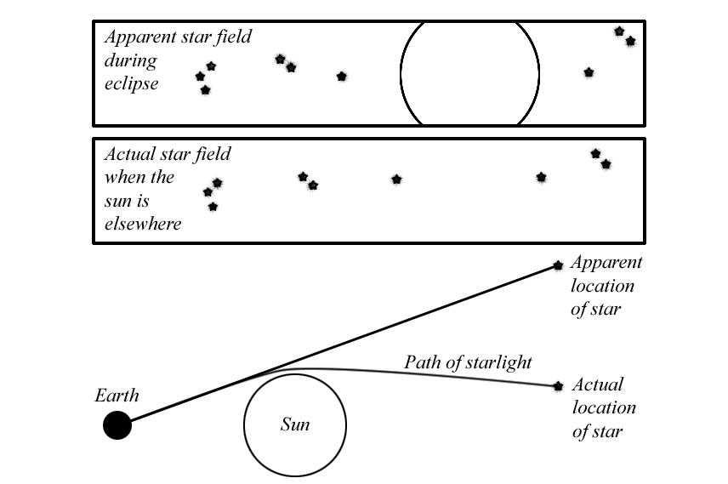
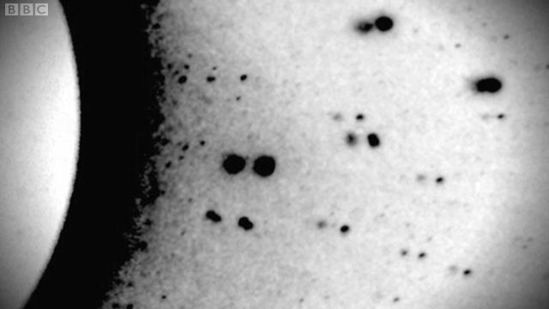
First Experimental Verification
In 1919, Einstein’s prediction of the bending of starlight were verified during a total solar eclipse by Sir Arthur Eddington.

Slide 10
Consequences of Matter’s Presence
Gravity distorts space, introducing fictitious forces – two apples following to Earth center.
Gravity distorts space changing world lines.
Flat space
Positively curved space
Negatively curved space
Curved space has “higher dimensionality” – consider Edwin Abbott’s Flatland

Slide 11
Consequences of Space Curvature
Flat or zero curvature:
Triangles = 180 degrees; parallel lines are parallel; one can travel in a straight line indefinitely, space unbounded
Positive curvature:
Triangles > 180 degrees, “parallel” lines converge, travel in a straight line and end up at start, space bounded
Negative curvature:
Triangles < 180 degrees, “parallel” lines diverge, travel in a straight line indefinitely, space unbounded
“Miracles” become understandable (Abbott)

Slide 12
Experimental Tests of GTR
Precession of the perihelion of Mercury
Explained that not explained by classical mechanics
Deflection of star light
Verified in 1919 solar eclipse
Gravitational reddening of Sirius B
Verified by spectral studies of the white dwarf star
Gravitational waves
Verified using binary pulsar and decay of period
Global positioning systems
GTR corrections required for onboard orbiting clocks

Slide 13
The Two Theories of Relativity
Special Theory (1905)
General Theory (1916)
Based on the question, “What would the world look like if I rode on a beam of light?”
Based on the question, “How does the presence of matter affect space?”

