Slide 1
GTR Continued

Slide 2
Einstein, GTR, and the Universe
Einstein’s equation of general relativity:
The equation required an expanding universe, so Einstein arbitrarily added a “cosmological” constant to avoid this conclusion…
Recall that galactic nebulas had yet to be discovered as galaxies, and neither had the expanding universe!

Slide 3
Friedmann’s Universe 1
Starts with total energy:
Makes 3 simplifying assumptions:
Universe is essentially empty (on a larger scale)
Universe is isotropic (no preferred direction)
Universe is homogeneous (no preferred point)
and gets:

Slide 4
Friedmann’s Universe 2
Inserting E=mc² and taking into account GTR, the prior equation results in:
where k is the curvature of the universe:
If k < 0, then universe is closed and bounded (positively curved).
If k > 0, then the universe is open and unbounded (negatively curved).
If k = 0, then the universe is flat.

Slide 5
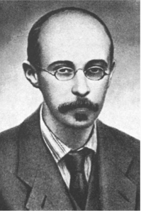
Friedmann’s Universe
Solving this equation, Friedmann predicted that the universe had to be expanding if it were to exist.
Einstein added the “cosmological constant” to his own field equations because he could not believe in an expanding universe. Later Einstein remarked, “That was the greatest scientific blunder that I ever made.”

Slide 6
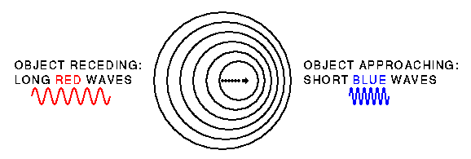
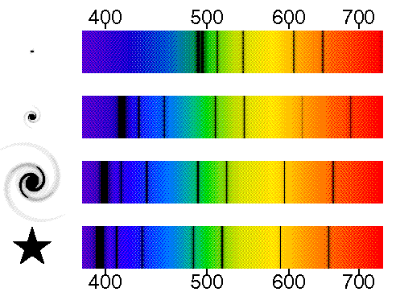
Hubble’s Relationship 1
Following in the footsteps of others, Hubble determines recessional velocities from Doppler shifts.

Slide 7
Hubble’s Relationship 2
Hubble determines distances to “nebulas” using a variety of means:
Study of variable stars whose periods are related to their intrinsic brightness
Angular diameters by type
Presence of brightest stars in a galaxy by type
Presence of globular star clusters
Presence of supernovas by type (I and II)

Slide 8
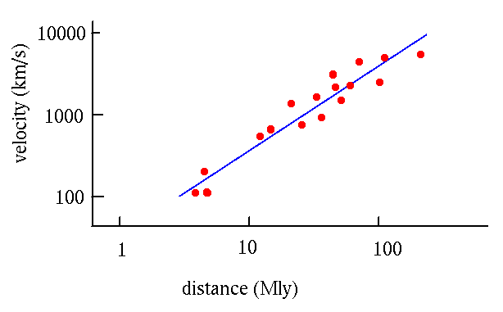
Hubble’s Law for Galaxies
Hubble used Doppler shifts and distances to study galaxies. He found a linear relationship.
v = HR

Slide 9
Abbé Georges Lamaître
Introduces the “Big Bang”
Concludes that time since universal expansion began could be found from Hubble parameter.
v = HR; now d/v = t;
v/R = H and d/v = 1/H
The current value of H (21-23km/s/Mly) shows the age of the universe to around 13.8 billion years.

Slide 10
Hubble’s Law is consistent with the expansion of the universe.

