Slide 1
Physics of the Cosmos

Slide 2
But first… the Cosmos
The Night Sky
The Milky Way
Stars (individual, binary, variable)
Clusters (globular and open)
Nebulae (reflection, emission, dark, planetary)
SNRs, Neutron Stars, & Black Holes
Galaxies
The Universe

Slide 3
The Night Sky

Slide 4
The Milky Way

Slide 5
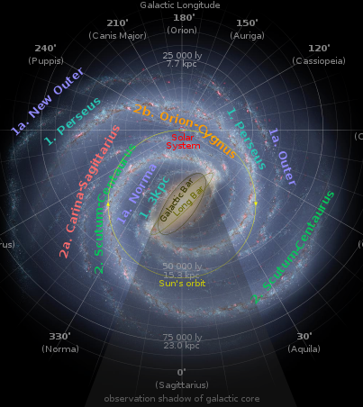
Galactic Structure

Slide 6
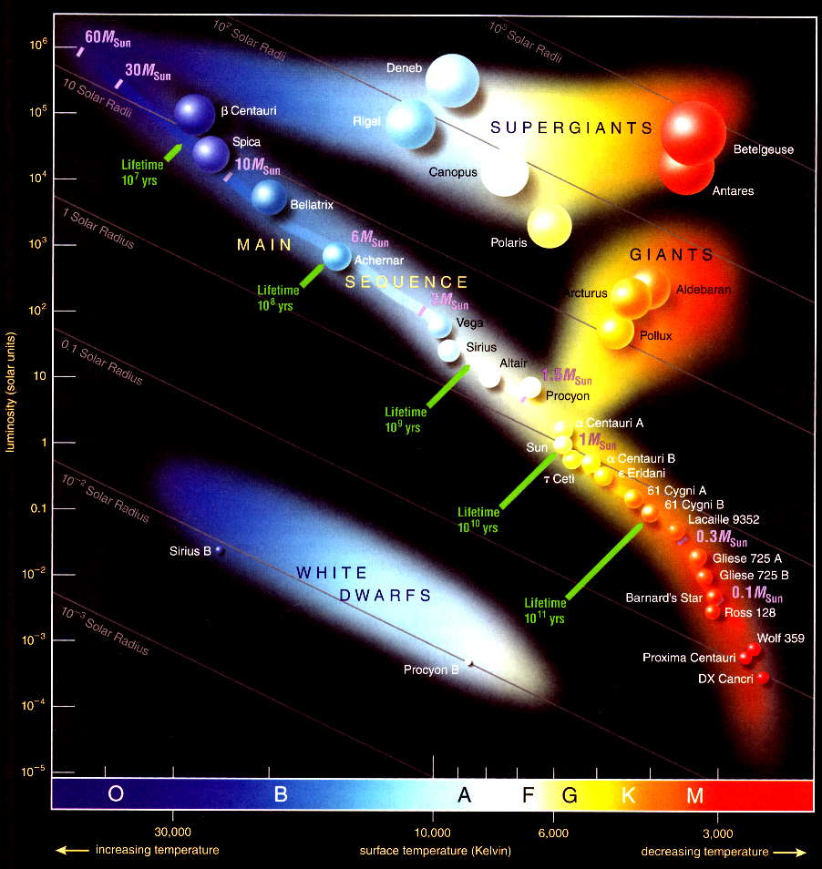
Individual Stars

Slide 7
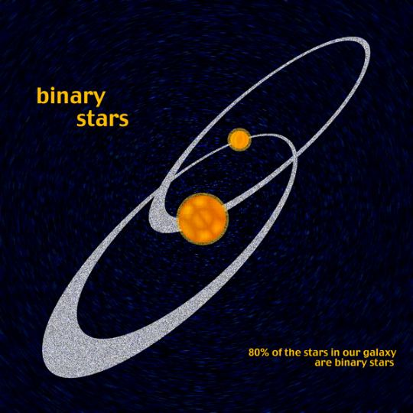
Binary Stars

Slide 8
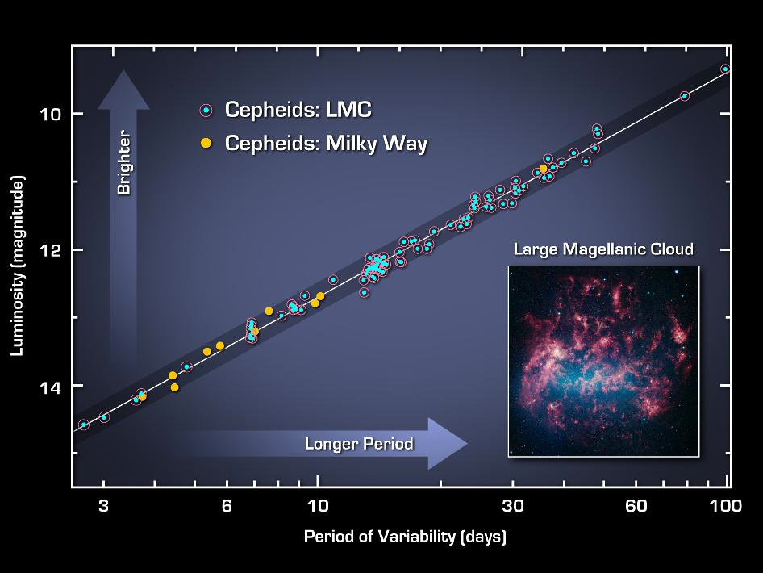
Variable Stars

Slide 9
Clusters
Open
Globular

Slide 10
Nebulae I
Emission
Dark

Slide 11
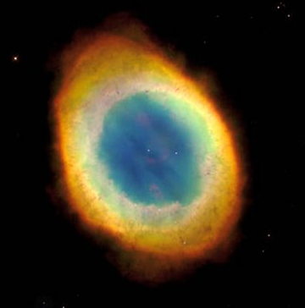
Nebulae II
Reflection
Planetary

Slide 12
SNRs, Neutron Stars & Black Holes
SNR with Neutron Star
Black Hole Model

Slide 13
Galaxies I
Spiral
Barred Spiral

Slide 14
Galaxies II
Elliptical
Irregular

Slide 15
The Universe

Slide 16
Matter & Radiation Dominance
The Big Bang started off immensely hot!
The time since the beginning of the universe is 1/H years or about 13.8 billion years.
Radiation dominated the early universe.
Matter dominance occurs after radiation “cools” enough for matter to condense per the relationship E=mc².

Slide 17
Matter Dominance (today)
The universe is composed mostly of matter.
Most of the past 13.8 billion years has been dominated by matter.
Our “horizon” is 13.8 billion light years away.
During this period, the rate of expansion has been slowing (but for some recent findings!)
In the past, H was much higher.

Slide 18
Radiation Dominance (early)
Radiation dominated the early universe.
The nature of the radiation was that of a black body radiator at an extremely high temperature.
Remnants of the early universe are BB-like, but strongly red-shifted.

Slide 19
Wien’s Law
T_{(°C)} = T_{(K)} - 273.15

Slide 20
Stefan-Boltzmann Law

