Slide 1
The Standard Model of the Atom

Slide 2
First Model of the Atom

Slide 3
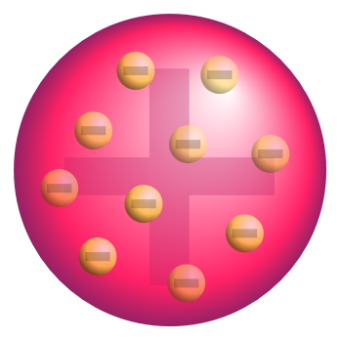
J. J. Thomson Model
“Plumb pudding” model based on electrostatics
An amorphous body combined of positive and negative charge.
The – electrons are more or less randomly distributed and the positively charged “pudding” holds it all together.

Slide 4
Rutherford’s Scattering Experiment
Scattering experiments showed the pudding model was wrong.
Atoms of metal (thin gold) scattered alpha particles – some back to the source.
Rutherford concluded gold layer must consist of hard nuclear cores at the center of atoms.

Slide 5
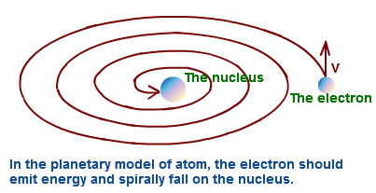
Rutherford’s Model of the Atom
A nucleus of p⁺ and nº and orbiting e–
A “solar system” model with a major problem.
Inward movement of electrons meant that they had to emit radiation due to conservation principles.

Slide 6
Bohr’s Model of the Atom
Bohr assumes that the energy of the photon is quantized and thus the orbits are fixed.
E = hf = hc/λ (λ discrete)
Photons are emitted when electrons drop to lower energy orbits.
Energy required by electrons to move up.

Slide 7
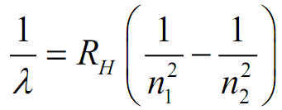
The Bohr Model 1
Successes
Kirchhoff’s Radiation Laws
Accurately predicted energy levels for the single-atom hydrogen, H; cf. Rydberg equation:
Accurately predicted wave-lengths of light for H atom while accounting for Kirchhoff’s radiation laws.

Slide 8
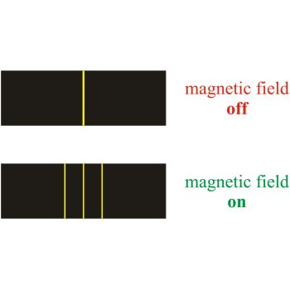
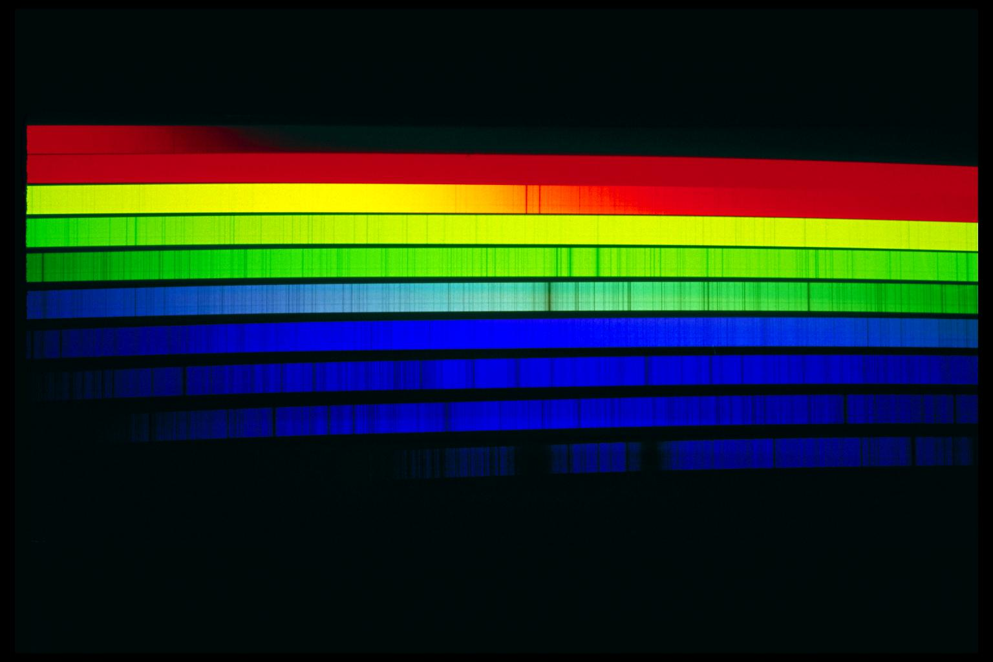
The Bohr Model 2
Failures
Spectra of multi-electron atoms could not be explained.
Could not explain the doubling of spectral lines in the presence of magnetic fields (Zeeman Effect).
Intensity of different spectral lines could not be explained.

Slide 9
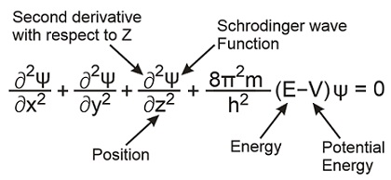
Subatomic Particle Zoo
First inklings of subatomic particles came from the study of radioactive emission in cloud chambers.
Later, Schrödinger and Heisenberg study waves following L. de Broglie.
https://www.youtube.com/watch?v=e3fi6uyyrEs

Slide 10
Quantum-Mechanical Model of Atom
Bohr’s orbits for electrons are replaced by probability distributions and include “spin” states (E. Schrödinger and W. Heisenberg).
Probing of the nucleus with “atomic knives” shows the nucleus to be made up of more than just neutrons and protons.
Enter the quarks…

Slide 11
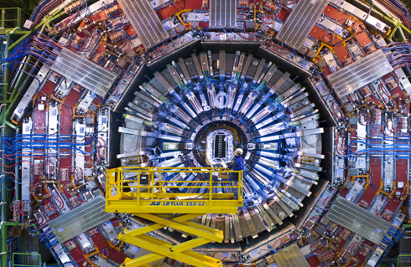
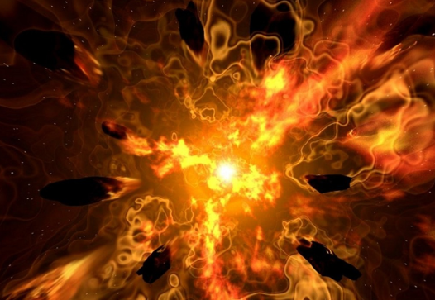
But first a thought…
Particle colliders such as the FermiLab Tevatron and the CERN Large Hadron Collider allow us to look back in time to the earliest state of the universe!
In the beginning (as with the Big Bang) the universe was hot and compressed – just like the conditions that prevail within a particle accelerator’s detectors.

Slide 12
Thoughts about Temperature
Multiple temperature scales:
Fahrenheit (ºF)
Celsius (ºC)
Kelvin (K) – a.k.a. “absolute” temperature
Relationship between temperature K and energy
<¹/₂mv²> = ³/₂kT (monatomic gas)
v is proportional to T (K) to the power of ½
Temperature is proportional to average particle energy.
Particle accelerators move particles to extremely high speeds and thus temperatures.

Slide 13
Particle Accelerators
Atomic “knives” cut to the heart of the nucleus.
Charged particles are accelerated in large magnetic rings with electric fields and are forced to collide with other such particles.
Collisions occur in large detectors that show results of collisions.

Slide 14
Colliders and Collisions

Slide 15
Making Sense of Scattering Results
Decay products are observed the conserve charge, spin, parity, as well as mass-energy, etc.
By varying electrical and magnetic fields and measuring the deflections of particles, protons, neutrons, and sub-atomic particles (even anti-matter) can be detected.
At higher energies, other strange materials result from the collisions.
When protons and anti-protons collide, they produce pure energy.
A “particle zoo” results from such collisions.
To make sense of the data, an even smaller set of objects called “quarks” was hypothesized to exist.

Slide 16
Subatomic Particles
A hadron is a composite particle made of hypothetical quarks held together by the strong force (in the same way at that atoms are held together by electrical force).
Hadrons are categorized into two families:
Baryons, such as protons and neutrons, made of three quarks and
Mesons, such as pions, made of one quark and one antiquark.

Slide 17
The Standard Model
Quarks are subatomic particles carrying a fractional electric charge, spin, and parity that are postulated as building blocks of the hadrons.
Leptons are subatomic particles that do not take part in the strong interaction.
“Strong” and “weak” forces operate only within the nucleus.

Slide 18
Higgs Boson
The Higgs boson is a massive elementary particle predicted to exist by the Standard Model of particle physics. It was discovered last year at CERN – the last missing piece of the nuclear puzzle.

Slide 19
