Slide 1
The Last Epoch

Slide 2
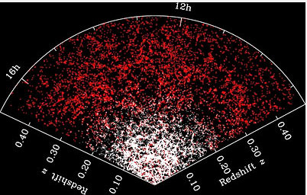
Cosmic Structure Formation
Today we have a matter-dominated universe ruled by the force of gravity.
Slight variations in density produces formation regions for stars and galaxies.
1st generation stars and galaxies have 74% H and 26% He by mass (just like the whole universe)
2nd gen stars are enriched

Slide 3
Star Formation
As H and He accrete, gas pressure increases limiting further growth unless there is sufficient matter; maximum star mass is about 60 M_{sun}.
The Jeans mass (≈ 10⁵ M_{sun}) constitutes the minimum amount of mass required for star formation (corresponds to globular star cluster).
Collapses of smaller clouds are helped along by:
stochastic processes (wakes of exploding stars or two or more gas clouds merging)
compression by magnetic field of galaxy

Slide 4
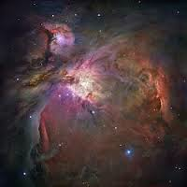
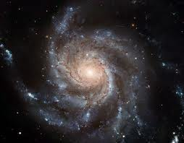
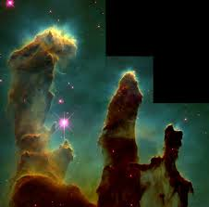
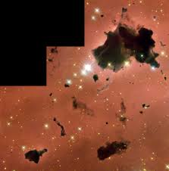
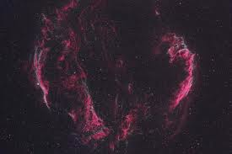
Star Formation Images

Slide 5
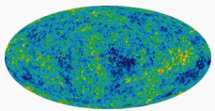
Wrinkles in Spacetime
COBE observed the cosmic microwave background, but there was an ever so slight variation in temperature (and thus density) from point to point across the sky.

Slide 6
Some problems with the Standard Model of Cosmology
The model of the expanding universe works quite well to explain:
Olber’s paradox
X, Y, and Z abundances (74%, 26%, 0%, and later)
Hubble’s relationship, v = HR
2.725K cosmic background radiation
Five major problems remain with model:
The Flatness Problem
The Horizon Problem
The Structure Problem
Dark Matter
Dark Energy

Slide 7
The Flatness Problem
If shortly after the Big Bang the universe was even remotely non-flat, we would not have the relatively flat universe we observe today.
Why did the universe’s original flatness balance on a knife’s edge when so many other possibilities existed?
Flatness is the midpoint between two extremes of curvature – positive and negative.

Slide 8
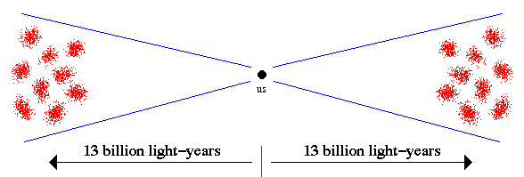
The Horizon Problem
The cosmic microwave background is amazingly uniform but for very minute variations equal to about 0.00001 K.
How is this possible when opposite “ends” of the universe cannot “communicate”?

Slide 9
The Structure Problem
If the universe was once entirely homogeneous and isotropic as we would expect from an early radiant universe, why is it no longer entirely so?
What cause the wrinkles in space that we spoke about earlier?

Slide 10
Inflationary Cosmology
In an attempt to solve the first three problems, the suggestion was made of an inflationary period in the early universe.
Between 10⁻³⁴ and 10⁻³² seconds after the Big Bang, the universe grew exponentially – from the size of a nucleon to approximately 85 LY.
When inflation is a part of the field equations, it solves the 3 problems mentioned earlier. (New 2014 evidence supports inflation.)

Slide 12
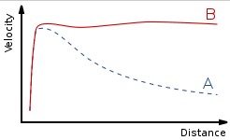
The Dark Matter Problem
The universe contains dark matter the nature of which is completely unknown.
Its presence is deduced from galactic rotation curves.

Slide 13
The Dark Energy Problem
Dark energy is an unknown form of energy hypothesized to permeate all of space.
It explains observations since the 1990s indicating that the universe is expanding at an accelerating rate.
The best current measurements indicate that dark energy contributes 68.3% of the total energy in the present-day observable universe.

Slide 14
Birth of a Star
Gravity, with a bit of help from various collisions, forms stars.
At the center of a cloud, T increases to 10 million Kelvin and the P-P cycle starts.
Gravity balanced by radiation pressure for a long period of time depending on mass.

Slide 15
Death of a Star
H–>He–>C–>N–>O–>
Near the end of their life spans, stars become red giants.
Three possible end states determined by the mass of the star:
White dwarf (low mass)
Neutron star (medium)
Black hole (high mass)

Slide 16
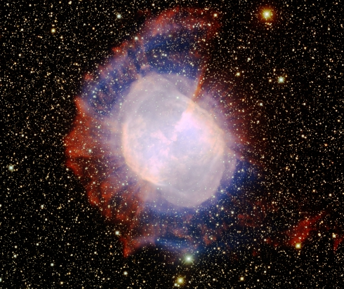
White Dwarfs
Produced in planetary nebula phase where atmosphere begins a run away process.
An Earth-sized core is revealed at 100,000K +

Slide 17
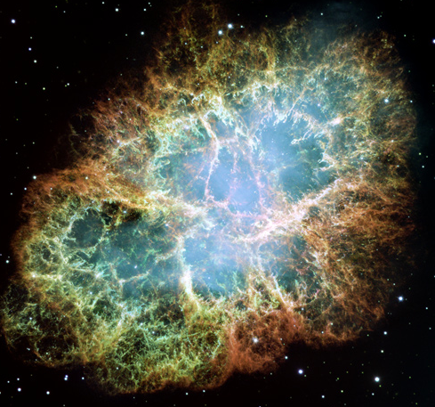
Neutron Stars
Produced during a supernova explosion resulting in a pulsar.
Protons and electrons are crushed to produce neutrons.

Slide 18
Black Holes
Produced in supernova explosions but neutron degeneracy cannot stop collapse.
Gravity is so strong that even light cannot escape.
Accretion disk (such as Cygnus X-1) often found in binary star systems.

Slide 19
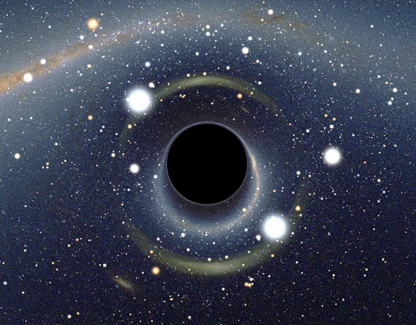
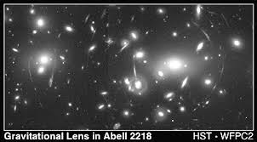
Black Hole Detection
X-ray sources
Gravitational effects on binary star companion
Gravitational lensing
Gravitational ripples
Accretion disk jets

