Slide 1
Rectilinear Motion

Slide 2
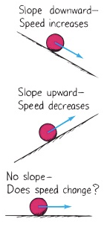
Galileo’s Study of Motion
Posited that constant uniform motion is quite natural contrary to the ancients.
Contradicted the Aristotelian view whereby any moving object required a mover.
Enunciated what has become known as Newton’s first law of motion – the law of inertia.

Slide 3
Rectilinear Motion
Rectilinear motion is straight-line motion:
Constant motion
Accelerated motion
The relationship between position, speed, and time found using Rene Descartes’ graphing.
Equation of a straight line: y = mx + b where:
y = variable on vertical axis
x = variable on horizontal axis
m = slope = [change in y]/[change in x]
b = y-intercept (the value of y when x = 0)

Slide 4
Position-Time Graphs
The slope, m, of a P-T graph is speed.
m = (y₂-y₁)/(x₂-x₁)
The slope has units (it depends on what is plotted)
A slope has meaning (depends on unit and sign)
The greater the slope, the greater the speed.
The y-intercept of a P-T graph is the position of a moving object at time equals zero – assuming constant motion.
For a constant motion vehicle, a graph’s slope is also constant unless its direction is reversed.

Slide 5
Interpreting Linear Graphs 1

Slide 6
Interpreting Linear Graphs 2

Slide 7
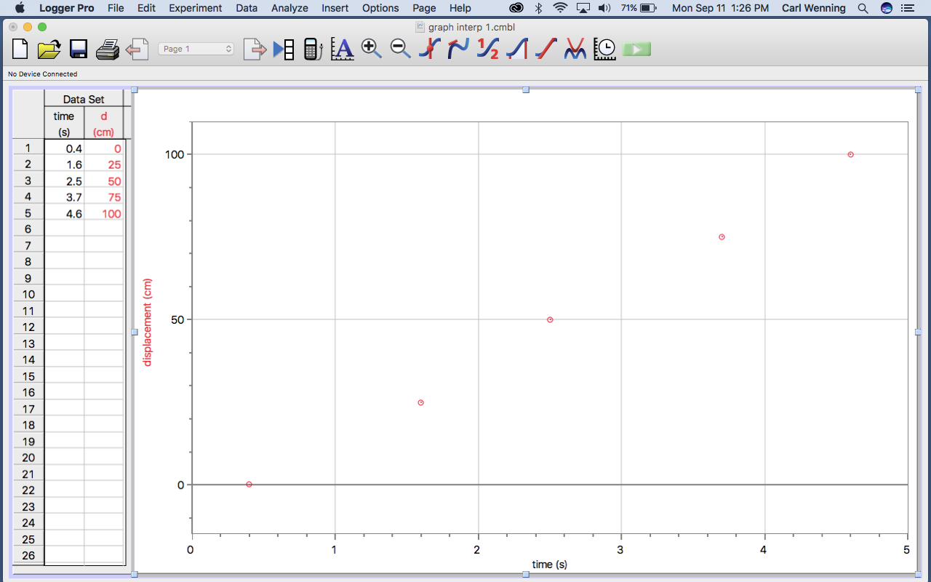

Slide 8
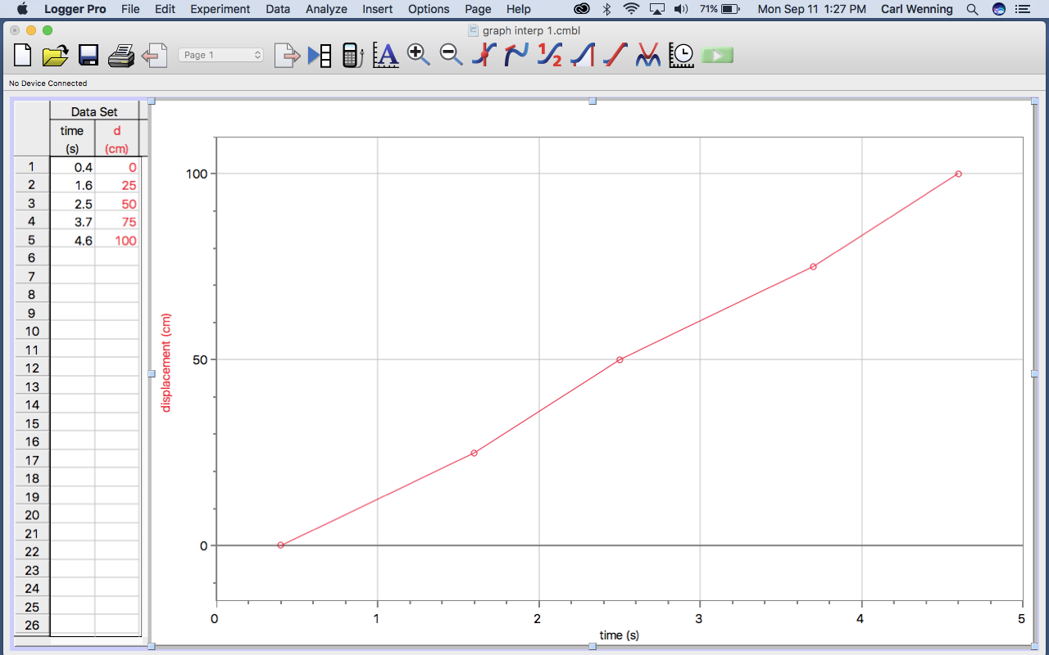

Slide 10
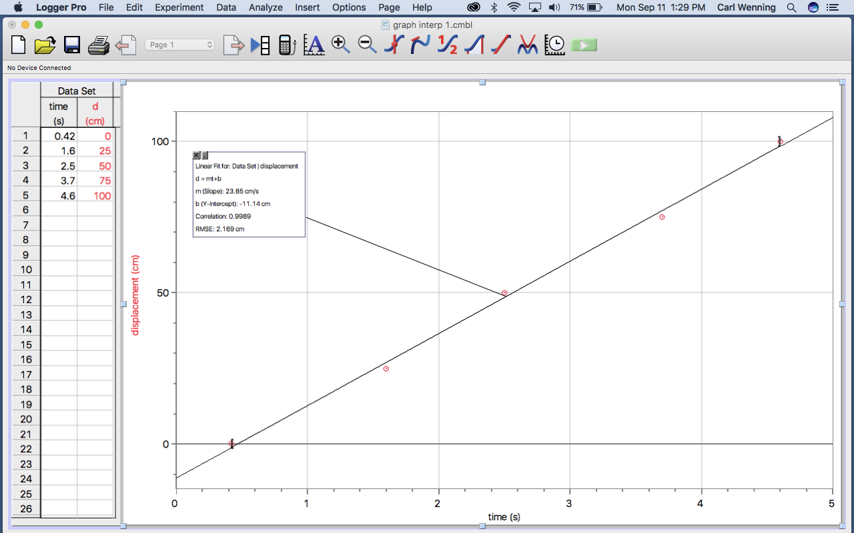

Slide 11
Graph Analysis
y = mx + b
m = 23.95 cm/s
b = - 11.14 cm
y = distance (d)
x = time (t)
distance = (23.95cm/s)*time – 11.14 cm
d = v*t + d_{o}

