Slide 1

The Levels of Inquiry
Model of
Science Teaching
Dr. Carl J. Wenning
Physics Department
Illinois State University
Normal, IL U.S.A.

Slide 2
Science teaching: Historical background
There have been many influential philosophers of education
Experiential Learning (J. Dewey)
Cognitive Load Theory (J. Sweller)
Conditions of Learning (R. Gagne)
Connectionism (E. Thorndike)
Constructivist Theory (J. Bruner)
Experiential Learning (C. Rogers)
Genetic Epistemology (J. Piaget)
Levels of Processing (Craik & Lockhart)
Multiple Intelligences (H. Gardner)
Situated Learning (J. Lave)
Social Development (L. Vygotsky)
Social Learning Theory (A. Bandura)
Subsumption Theory (D. Ausubel)
Information Processing Theory (G. Miller)
but none has dealt effectively with teaching
science using inquiry-oriented approaches.

Slide 3
Attempts to help: Definitions of inquiry
National Science Education Standards – NRC
National Science Teachers Association - NSTA
“Scientific inquiry refers to the diverse ways in which scientists study the natural world and propose explanations based on the evidence derived from their work. Inquiry also refers to the activities of students in which they develop knowledge and understanding of scientific ideas, as well as an understanding of how scientists study the natural world.”
“Scientific inquiry is a powerful way of understanding science content. Students learn how to ask questions and use evidence to answer them. In the process of learning the strategies of scientific inquiry, students learn to conduct an investigation and collect evidence from a variety of sources, develop an explanation from the data, and communicate and defend their conclusions.”

Slide 4
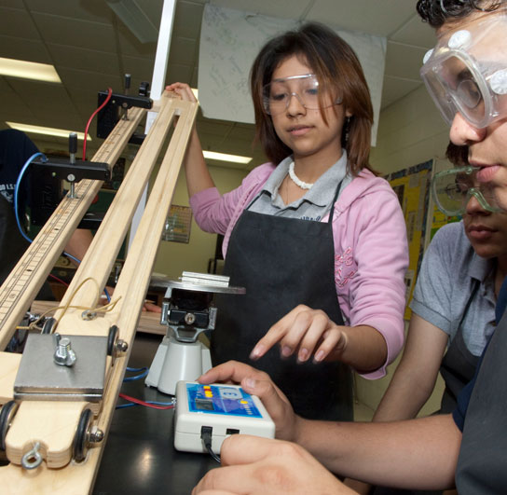
There is a greater need for guidance.
Science teaching
A life-changing event
Traditional approaches:
  teacher seen as authority
  “received” knowledge
  emphasis on equations
Inquiry approaches:
  teacher seen as facilitator
  construction of knowledge
  emphasis on conceptual understanding in addition to applications

Slide 5
What is inquiry-oriented teaching?
Inquiry-oriented teaching:
is student-centered instruction.
sees the teacher as a guide, not an authority figure.
focuses on questions rather than answers.
uses an epistemology based on student experience rather than faith in the teacher.
is in need of clearly defined approaches that will systematically teach all the scientific and intellectual process skills expected of someone who is scientifically literate.

Slide 6
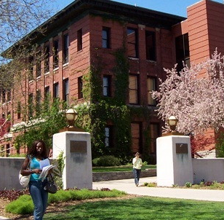
Levels of Inquiry Model of Science Teaching
Moulton Hall at I.S.U.
Talk Outline
What is Inquiry?
The Inquiry Spectrum
Intellectual Process Skills
LI Model Learning Cycle
Learning Sequence Demo
The Future of the LI Model

Slide 7
Two fundamental questions:
What are the goals of science teaching?
Teaching science as both content and process.
Teaching nature and history of science.
Teaching critical thinking and authentic inquiry-oriented problem-solving skills.
Teaching scientific dispositions.
How do we best teach critical thinking and authentic inquiry-oriented problem-solving skills?
Levels of Inquiry Method of Science Teaching - Motivation

Slide 8
The Inquiry Spectrum
How Inquiry Spectrum levels differs from each other:
  Intellectual sophistication increases from left to right.
  Locus of control shifts from teacher to student going left to right.
  Each level has a different pedagogical purpose.
  Each level promotes different intellectual skills.
Discovery Learning | Interactive Demonstrations | Inquiry Lessons | Inquiry Labs | Real-world Applications | Hypothetical Explanations

Slide 9
Discovery Learning
Pedagogical Purpose
Students develop concepts on the basis of first-hand experiences
Discovery Learning | Interactive Demonstrations | Inquiry Lessons | Inquiry Labs | Real-world Applications | Hypothetical Explanations
Rudimentary Skills:
Observing
Formulating concepts
Estimating
Drawing conclusions
Classifying results

Slide 10
Interactive Demonstrations
Pedagogical Purpose
Students are engaged in explanation and prediction-making that allows teacher to elicit, identify, confront, and resolve alternative conceptions
Discovery Learning | Interactive Demonstrations | Inquiry Lessons | Inquiry Labs | Real-world Applications | Hypothetical Explanations
Basic Skills:
Predicting
Explaining
Estimating
Acquiring and processing data
Formulating and revising scientific explanations

Slide 11
Inquiry Lessons
Pedagogical Purpose
Students identify scientific principles and/or relationships
Discovery Learning | Interactive Demonstrations | Inquiry Lessons | Inquiry Labs | Real-world Applications | Hypothetical Explanations
Intermediate Skills:
Measuring
Collecting and recording data
Constructing a table of data
Designing and conducting scientific investigations

Slide 12
Inquiry Labs
Pedagogical Purpose
Students establish empirical laws based on measurement of variables.
Discovery Learning | Interactive Demonstrations | Inquiry Lessons | Inquiry Labs | Real-world Applications | Hypothetical Explanations
Integrated Skills:
Measuring metrically
Establishing empirical laws on the basis of evidence and logic
Using math & technology in investigations

Slide 13
Real-world Applications
Real-world Applications
Students solve numerical problems related to authentic situations while working in cooperative and collaborative groups using problem-based and project-based approaches.
Discovery Learning | Interactive Demonstrations | Inquiry Lessons | Inquiry Labs | Real-world Applications | Hypothetical Explanations
Culminating Skills:
Collect, assess, and interpret data from a variety of sources
Construct reasoned arguments based on scientific evidence
Make and defend evidence-based decisions and judgments
Clarify values in relation to natural and civil rights
Interpersonal skills

Slide 14
Hypothetical Explanations
Pedagogical Purpose
Students generate explanations for observed phenomena.
Discovery Learning | Interactive Demonstrations | Inquiry Lessons | Inquiry Labs | Real-world Applications | Hypothetical Explanations
Advanced Skills:
Synthesizing and testing complex hypothetical explanations
Analyzing and evaluating scientific arguments

Slide 15
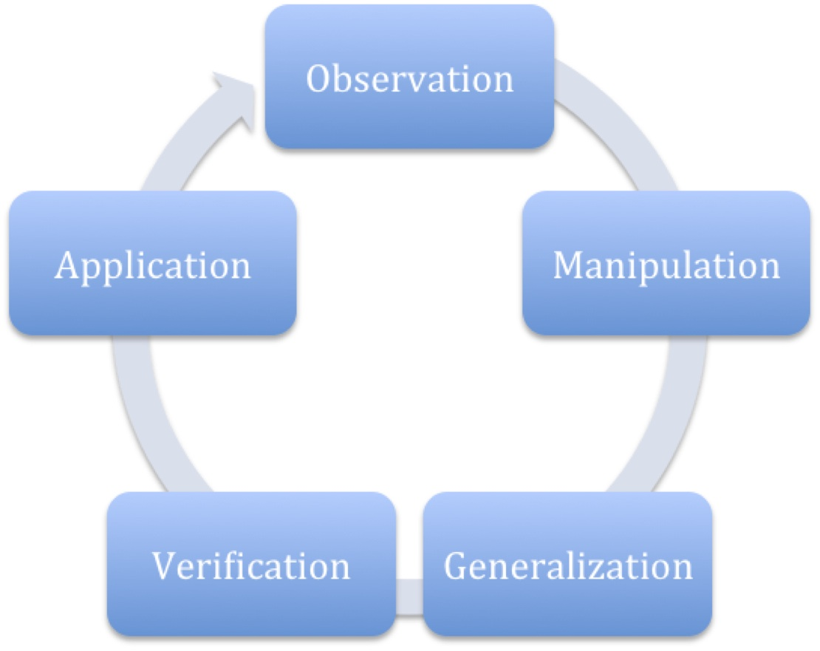
Levels of inquiry learning cycle

Slide 16
Learning sequence example: Buoyancy
Buoyancy | Pedagogical Practice – Sinking Objects
Discovery Learning | Students experience floating and sinking as well as buoyant force.
Interactive Demonstrations | Students develop a relationship between weight in air, in water, and the buoyant force.
Inquiry Lessons | Students identify factors that might influence buoyant force and conduct simple tests.
Inquiry Labs | Students establish empirical law for volume of immersed object and density of liquid, F=ρVg.
Real-world Applications | Students apply new knowledge to authentic situations.
Hypothetical Explanations | Students generate explanations for pressure at depth, P=ρgh, and source of buoyant force.

Slide 17
Levels of Inquiry Model Application
Curriculum Planning
Teach the subject matter that you can best teach using inquiry-oriented approaches.
Instructional Development
Prepare learning sequences that incorporate all levels of inquiry to the greatest extent possible.
Discovery Learning | Interactive Demonstrations | Inquiry Lessons | Inquiry Labs | Real-world Applications | Hypothetical Explanations

