Slide 1
The Modeling Method of Instruction for Science and Mathematics
Arizona State University Modeling Method Web Site
Notes:
1

Slide 2
Why a different approach to science and mathematics instruction?
Research shows that after conventional instruction, students could not fully explain even the simplest of concepts, even though many could work related problems.
Worse yet, conscientious conventional instruction delivered by talented (and even award-winning teachers) did not remedy the situation significantly.

Slide 3

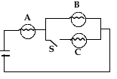
Do our students really understand?
What does it mean when students can readily solve the quantitative problem at left, yet not answer the conceptual question at right?
For the circuit above, determine the current in the 4  resistor and the potential difference between P and Q.
Bulbs A, B and C are identical. What happens to the brightness of bulbs A and B when switch S is closed?

Slide 4
What has NOT made a difference in student understanding?
lucid, enthusiastic explanations and examples
dramatic demonstrations
intensive use of technology
textbooks
lots of problem solving and worksheets

Slide 5
Any theory of instruction must answer two questions.
What should students learn?
How should students learn?
Conventional answers:
  Tell the students as much as you can.
  Show the students as much as you can.

Slide 6
Basic assumption of conventional instruction
Students have the same mental models the instructor does. (NOT warranted by assessment results or interviews with students.)

Slide 7
Why does conventional instruction fail?
It is founded on folklore, hearsay, and casual observation.
It typically emphasizes “plug and chug” techniques to work problems.
It is not systematically refined based upon objective feedback.

Slide 8
What do students see as important in a traditional classroom?
Equations
Similar steps in solving problems
Numerical answers
But where’s the conceptual understanding?

Slide 9
How is the modeling classroom different?
It is student centered vs teacher centered.
Students are active vs passive.
Emphasis is on cognitive skill development vs knowledge transfer.
Students construct and evaluate arguments vs finding the right answer.
Teacher is Socratic guide vs the main authority.

Slide 10
The Modeling Method seeks to foster these views:
Science is coherent
  as opposed to the view that science consists of a set of loosely related concepts and problems
Learning occurs when students actively seek understanding
  as opposed to the view that learning consists of taking notes, listening to the teacher, memorizing facts/formulas, etc.

Slide 11
Problems rather than models?
Students come to see problems and their answers as the units of knowledge.
Students fail to see common elements in novel problems.
    “But we never did a problem like this!”

Slide 12
Focusing on models rather than numerical problems!
Emphasis is placed on identifying the underlying structure of the system.
Students identify or create a model and make inferences from the model to produce a solution.
A few basic models are used again and again with only minor modifications.

Slide 13
What is a model?
A model is a representation of structure in a physical system and/or its properties.
The model has multiple representations, which taken together define the structure of the system.

Slide 14
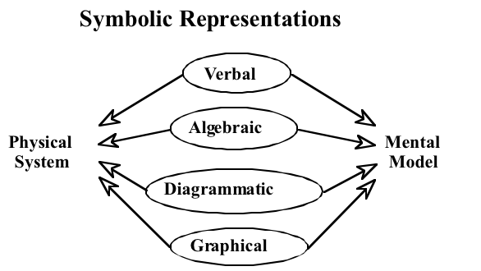
The model is distributed over multiple representations

Slide 15
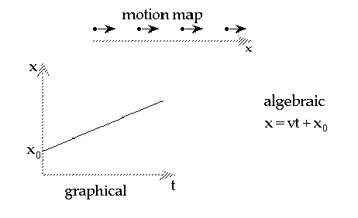
Multiple representations
a particle moving at constant velocity
with explicit statements describing relationships

Slide 16
Modeling is science as inquiry
Modeling is consistent with NSES content standards for grades 9-12.
  Formulate and revise scientific explanations and models using logic and evidence.
    “Student inquiries should culminate in formulating an explanation or model.”
    “In the process of answering questions, the students should engage in discussions and arguments that result in the revision of their explanations.”

Slide 17
How does the Modeling Method foster student understanding? (pt 1)
Students design their own experimental procedures.
Students must justify their interpretations of data in teacher-guided Socratic dialogs.
Models created from experimental interpretations are deployed in carefully selected problems, each of which is designed to illustrate aspects of the model.

Slide 18
How does the Modeling Method foster student understanding? (pt 2)
Solutions are presented by students to the entire class on whiteboards.
Acceptable solutions reveal how a model (or models) accounts for the behavior of some physical system.
Acceptable solutions are fully explicated using multiple representations.

Slide 19
Justification of the model
Explicit appeal to an interpretation of an experimental result
Common questions:
  “Why did you do that?”
  “Where did that come from?”
  “How did you know to do that?”
Unless students can explain something fully, they do not understand it!

Slide 20
How does Modeling change the work of the instructor?
Designer of experimental environments.
Designer of problems and activities.
Critical listener to student presentations, focusing on what makes good arguments in science.
Establishes a trusting, open, “OK to make a mistake” classroom atmosphere.
No longer “the sage on the stage”.

Slide 21
Implementation results
20,000 students nationwide, over 300 classes, from HS to graduate levels
Substantial gains on FCI results
Long term retention of fundamental physics concepts

Slide 22
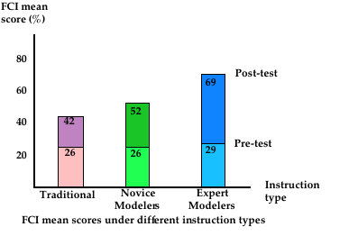
Effectiveness of Modeling Method of Physics Instruction

Slide 23
Stage I: Model development
Description
Formulation
Ramifications
Validation

Slide 24
Stage I: Model development
description
Students describe their observations of the situation under examination.
Teacher is non-judgmental moderator.
Students are guided to identify measurable variables.
Dependent and independent variables are determined.

Slide 25
Stage I: Model development
formulation
Relationship desired between variables is agreed upon.
Discussion of experimental design.
Students develop details of a procedure.
Minimal intrusion by teacher.

Slide 26
Stage I: Model development
ramification
Students construct graphical and mathematical representations.
Groups prepare and present whiteboard summaries of results.
Model is proposed.

Slide 27
Stage I: Model development
validation
Students defend experimental design, results, and interpretations.
Other groups are selected to refute or to corroborate results.
Socratic discussion heads towards consensus of an accurate representation of the model.

Slide 28
Stage II: Model deployment (pt 1)
Students learn to apply model to variety of related situations.
  identify system composition
  accurately represent its structure
Students articulate their understanding in oral presentations
Students are guided by instructor's questions:
    Why did you do that?
    How do you know that?

Slide 29
Stage II: Model deployment (pt 2)
New situations for the same model.
Contextual link to paradigm lab is cut.
Groups work on solving carefully chosen problems each of which exhibits an application of the model.
Each group whiteboards one problem for presentation to the class.
Results defended and discussed.
Notes:
31

Slide 30
Modeling materials as teaching resources
Use freely available Modeling Modeling resources; there is no need to reinvent the wheel!
Use Modeling materials to:
  Prepare unit plans
  Prepare lesson plans
  Prepare STERS plans
  Student teach
  First years of teaching
Take advantage of years of effort by in-service teachers!

Slide 31
Caveat: Modeling resources do not meet all expectations of the NSES.
Missing are critical components:
  Philosophical and historical nature of science
  Issues related to science and technology
  Technological applications of science
There can be an over reliance on worksheets at the cost of developing a broader spectrum of scientific reasoning and authentic problem-solving skills
  Be certain to use learning sequences associated with the Inquiry Spectrum – especially at the higher cognitive levels (Wenning, 2005 and 2010; see www.phy.ilstu.edu/pte/publications/ )
Modeling web site: http://modeling.asu.edu/

