Slide 1
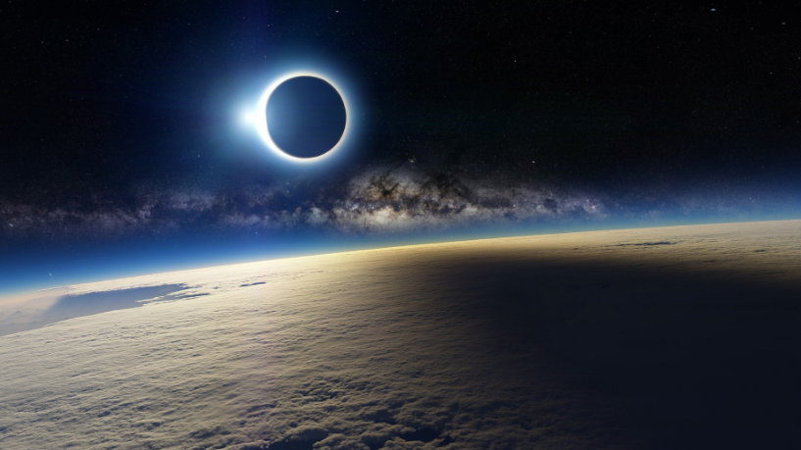
What we will see…
(assuming the sky is clear)

Slide 2
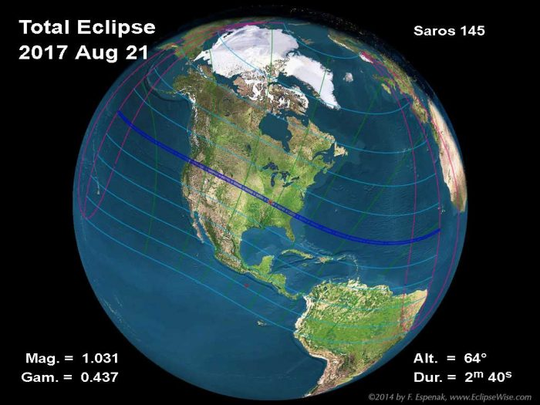
What we will see is strongly dependent upon our location

Slide 3

What we will see if we view from Twin Cities
93% obscuration of the sun (major partial eclipse)
Partial eclipse begins 11:52 AM
Maximum eclipse 1:26 PM
Partial eclipse ends 2:43 PM
Altitude 60.8 degrees
Azimuth 193.6 degrees

Slide 4

What we will see if we view from Carbondale
100% obscuration of the sun
Duration of totality 2m 37.2s
First contact 11:52 AM
Beginning of Totality 1:20 PM
Maximum Eclipse 1:21 PM
Ending of Totality 1:23 PM
Fourth contact 2:47 PM
Altitude 63.7 degrees
Azimuth 192.0 degrees

Slide 5
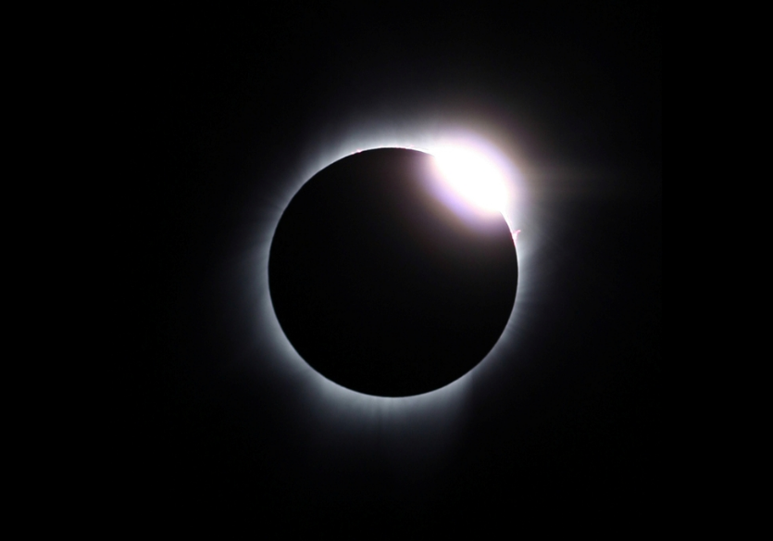
The sun near totality – Diamond Ring Effect

Slide 6
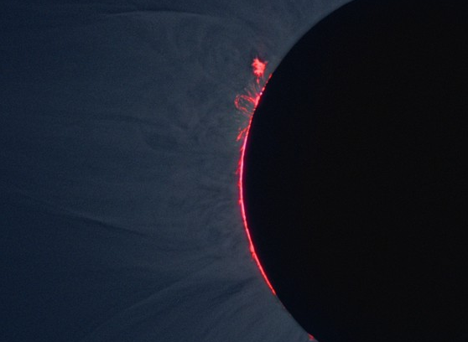
The sun near totality - Prominences

Slide 7
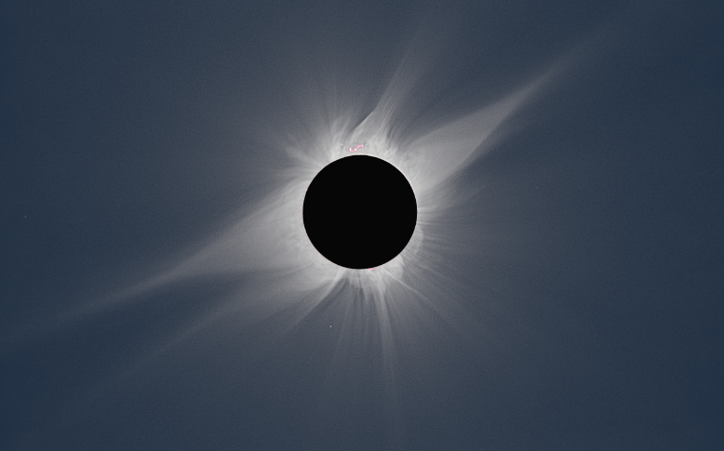
The sun at totality

Slide 8
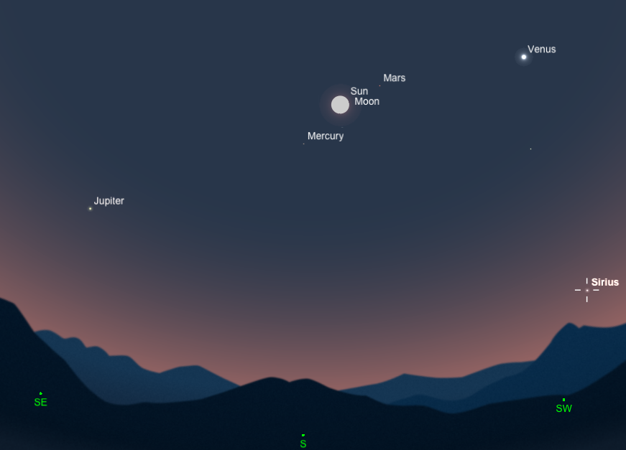
The sky during totality

