Slide 1
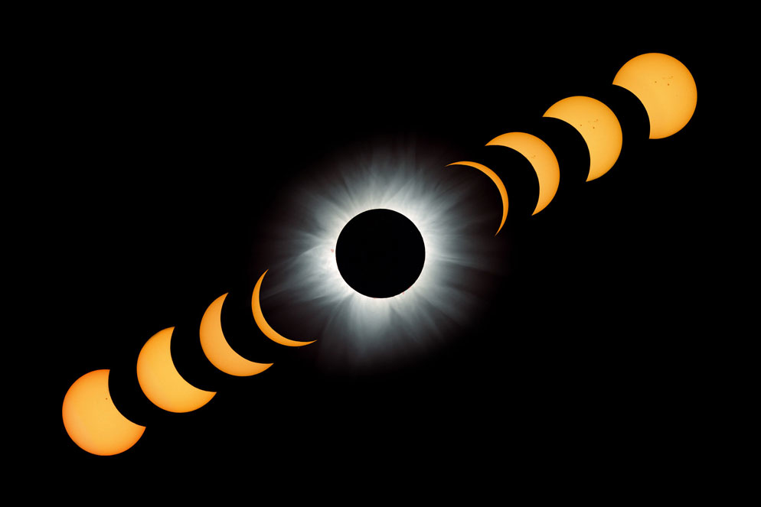
Getting Ready for 2017
Dr. Carl J. Wenning

Slide 2
The wait is nearly over!
Monday, August 21, 2017

Slide 3
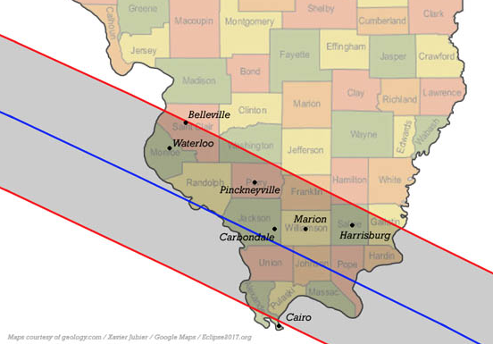
Illinois Ground Path
Central Eclipse ~ 1:22 p.m.

Slide 4
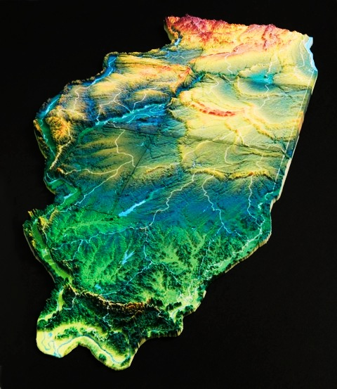
Circumstances of 2017 Eclipse
Eclipse magnitude = 1.0306
Greatest duration is 2 minutes, 40.2 seconds
Greatest duration occurs in Shawnee National Forest just south of Carbondale, IL
Path of totality 115km wide (70 miles)

Slide 5
Major Eclipse Types
Total
Annular

Slide 6
Eclipse as seen from the moon

Slide 7
Total Solar Eclipse April 8, 2024

Slide 8
Annual Eclipse October 14, 2023

Slide 9
Personal Impressions

Slide 10
2017 Illinois Eclipse Guide

