Slide 1
BAD ASTRONOMY
MISCONCEPTIONS:
A mistaken thought, idea, or notion; a misunderstanding The American Heritage® Dictionary of the English Language
The 5-step process of eliciting, identifying, confronting, resolving, and reinforcing mentioned in Dr. Wenning’s paper, Dealing more effectively with alternative conceptions in science

Slide 2
HOW DO WE CHANGE A STUDENT’S WAY OF THINKING?
The Conceptual Change Model suggests that when a new concept is learned it weakens or destroys an existing memory.
Efforts must be undertake to help students forget an inaccurate conception. Teachers must help students “forget,” and this involves more than just letting old memories fade. Instead, we must work to actively replace old memories with new, helping students to see how their initial ideas fit within the framework of scientific understanding. (Dr. Wenning: J. Phys. Tchr. Educ. Online, 5(1), Summer 2008)

Slide 3
STATE GOAL 12: Understand the fundamental concepts, principles and interconnections of the life, physical and earth/space sciences.
Why This Goal Is Important
These ideas have been thoroughly studied and have stood the test of time.
Knowing and being able to apply
A working knowledge of these concepts and principles

Slide 4

Bad Astronomy: The sky is blue because it reflects light from the oceans.

Slide 5

Good astronomy: The sky is blue because it is scattering blue light from the sun.
Sunlight may look white, but actually it is made up of many colors.
When a stream of photons of all different colors comes into the atmosphere, the red, orange, yellow, and even green ones tend to get through unimpeded. But the photons that are more blue tend to get scattered away.
This is why the sky is blue!

Slide 6
Some great websites to help students understand this concept:
http://spaceplace.nasa.gov/en/kids/misrsky/misr_sky.shtml
http://www.cs.dartmouth.edu/farid/sciencekids/bluesky.html
http://www.sciencemadesimple.com/sky_blue.html
http://sxxz.blogspot.com/2007/11/why-is-sky-blue.html (This site has some great experiments)
http://www.all-science-fair-projects.com/science_fair_projects/91/744/16407782c33b283e4a056fa55a701a4c.html

Slide 7
Bad Astronomy: The seasons are caused by the change in the distance of the Earth to the Sun.

Slide 8
Good astronomy: The seasons are mostly due to the axial tilt of the Earth. The change in distance of the Earth to the Sun is a very minor player.
The Earth revolves around the Sun.
The North pole always points the same way as the Earth revolves around the Sun.
The Earth's movement around the sun causes the seasons.
When the Earth's axis points towards the Sun, it is summer for that hemisphere. When the Earth's axis points away, winter can be expected.

Slide 9
Some great websites to help students understand this concept:
http://www.woodlands-junior.kent.sch.uk/time/seasons.htm
http://www.explorelearning.com/index.cfm?method=cResource.dspDetail&ResourceID=407
http://csep10.phys.utk.edu/astr161/lect/time/seasons.html
http://astro.unl.edu/classaction/animations/coordsmotion/eclipticsimulator.html (simulator)
http://projects.astro.illinois.edu/data/Seasons/seasons.html (simulator)

Slide 10
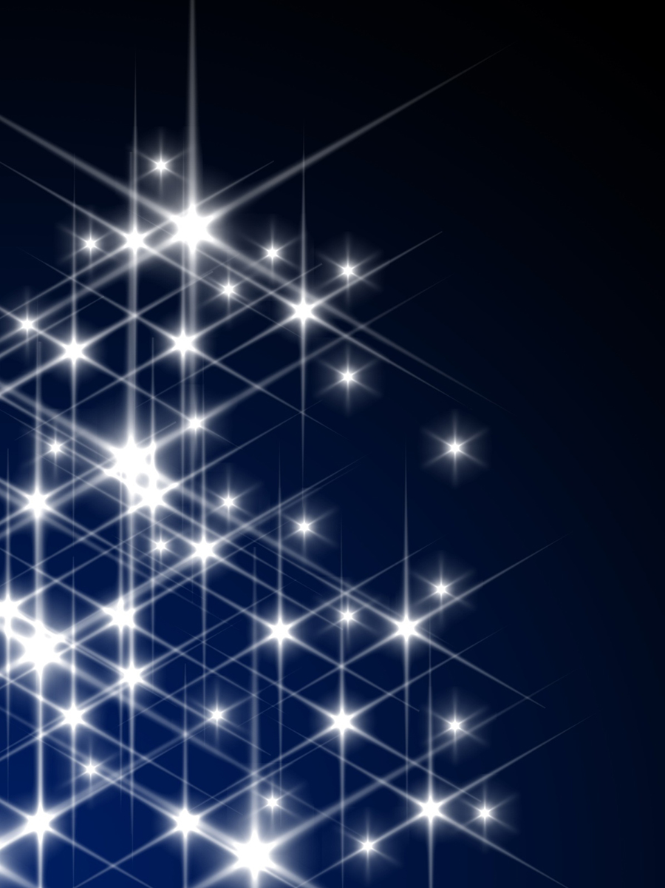
Bad Astronomy: All stars that you can see at night are white.

Slide 11

Good Astronomy: Stars actually emit all the colors of the rainbow. Literally! !
Most people don't really think about stars having colors, so they tacitly assume all stars are white. But look at the Sun! It looks yellow to me, and it's a star!
This one is easy to disprove by yourself. Go outside on a clear night and look at the stars. The best ones to look at are the brightest. In the Summer, Vega is a bright star high overhead, and is clearly blue. Antares is another summer star and is also clearly red (or orange). In the Winter, you can see Betelgeuse in the constellation of Orion, which is very red. Aldebaren, a star in Taurus (near Orion) is also very red.

Slide 12
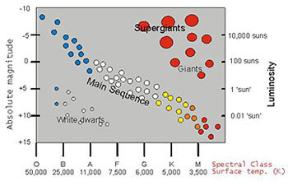
Some great websites to help students understand this concept:
http://docs.kde.org/development/en/kdeedu/kstars/ai-colorandtemp.html
http://domeofthesky.com/clicks/bv.html
http://www.synapses.co.uk/astro/colors.html
http://coolwiki.ipac.caltech.edu/index.php/Color-Magnitude_and_Color-Color_plots
http://stardate.org/teachers/plans

Slide 13
LESSON PLAN WEBSITES
http://www.middleschoolscience.com/earth.htm
http://geology.com/teacher/astronomy-space.shtml
http://www.physics.rutgers.edu/hex_old/visit/lesson/lesson_index.html
http://www.discoveryeducation.com/search/page/6-8/-/lesson-plan/-/index.cfm?Ntx=mode+matchallpartial&Ntk=all-prelogin&Ne=4294967201&Nr=AND(OR(d_Index_Type:Pre-login))&N=33+4294967201+4294967275
http://www.instructorweb.com/resources/astronomy.asp

