Slide 1
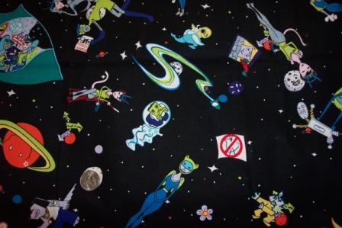
Bad Astronomy

Slide 2
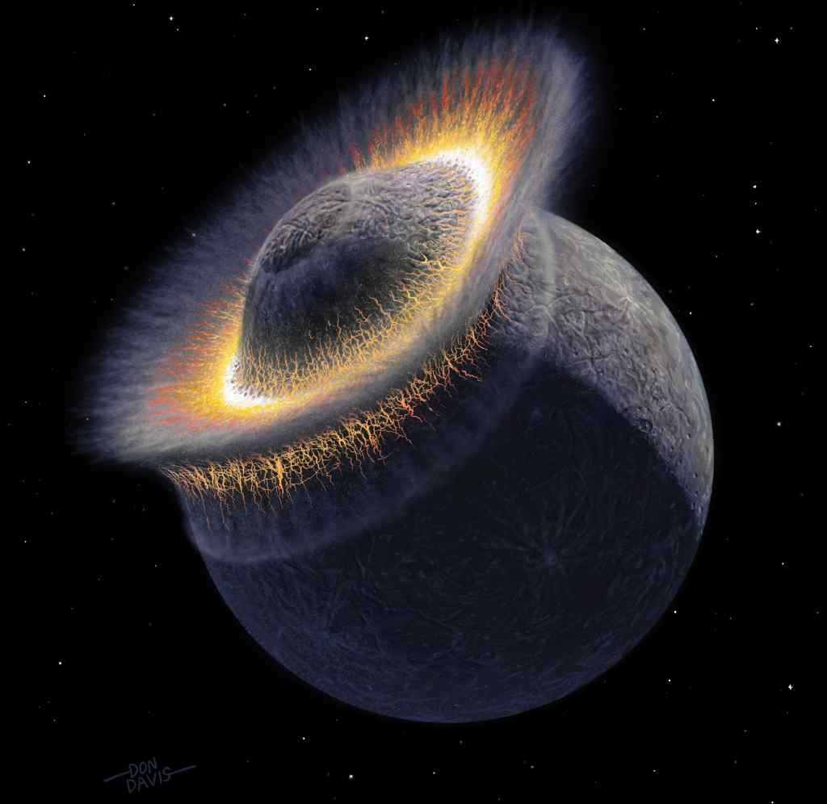
“My brother says that Pluto is still a planet, and that you are wrong! It has merged with Planet X, and it is really big.”

Slide 3
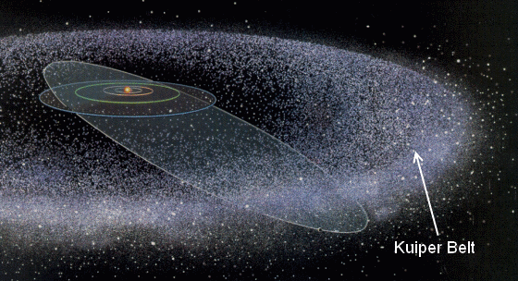
Illinois Standard 12.F3b
*Describe the organization and physical characteristics of the solar system.

Slide 4
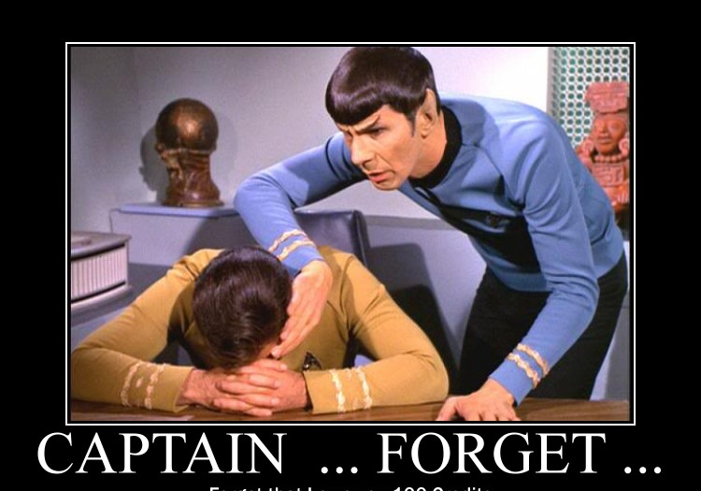
Forget Forget

Slide 5
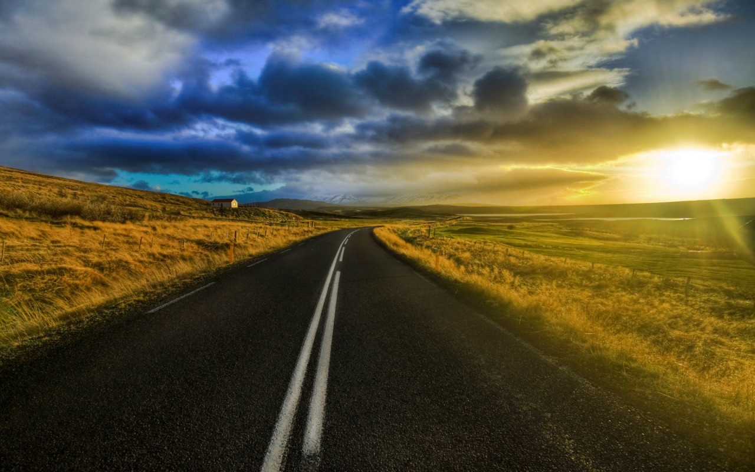

New Paths

Slide 6
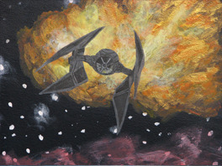
There is sound in outer space.

Slide 7
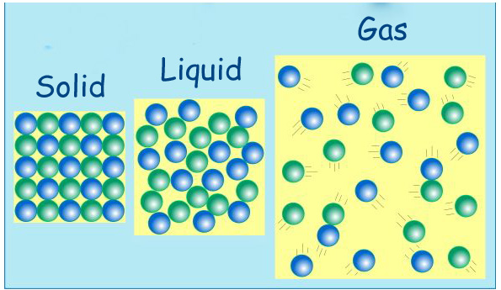
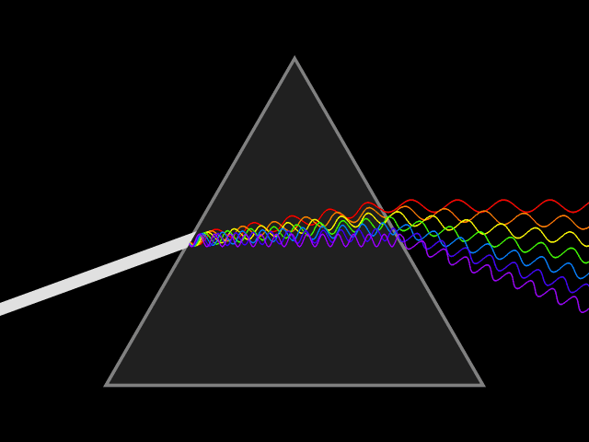
Illinois Standard 12.C2a
*Describe and compare types of energy: light and sound.

Slide 8

The surface of the sun is without visible features.

Slide 9
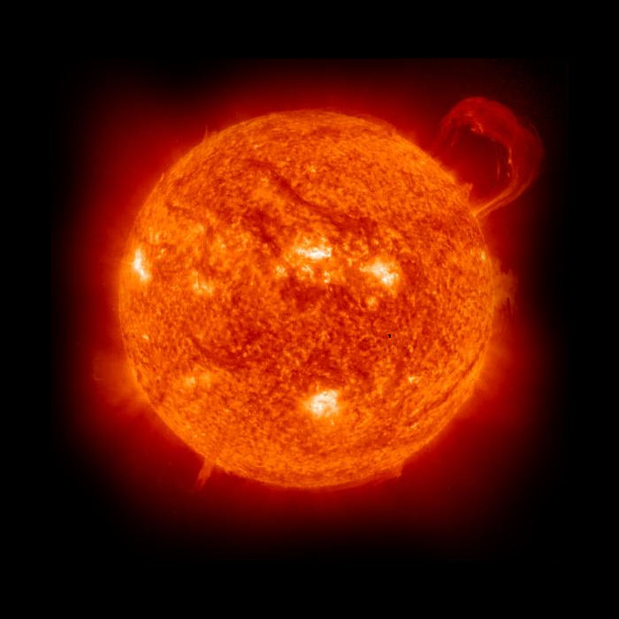
Illinois Standard 12.F2a
*Identify and explain natural cycles and patterns in the solar system.

